Slide 1
Applications of data analytics in auditing
www.pwc.com
Notes:
Time on slide: 0 minutes
Overall Elapsed Time: 0 minutes
Instructor Notes:
Say:
Welcome to the Application of Data Analytics in External Audit course.
Do:
Facilitator introductions.
Q&A:
N/A

Slide 2
Course contents
Overview
Key areas of application
2a Internal controls
2b Substantive testing
2c Risk assessment
Case study
Questions
Notes:
Time on slide: 1 minute
Overall Elapsed Time: 1 minute
Instructor Notes:
Say:
In this course, we will explore how data analytics is applied in external audit, including the areas of internal controls, substantive testing and risk assessment. At the end of the course, we will explore students understanding of the material with a case study relating to journal entry testing.
Do:
N/A
Q&A:
N/A

Slide 3
Overview
The right mix of mind and machine can help reduce the impact of human bias and yield more accurate answers, even for complex problems.
http://www.pwc.com/us/en/advisory-services/data-possibilities/big-decision-survey.html
Notes:
Time on slide: 1 minute
Overall Elapsed Time: 2 minutes
Instructor Notes:
Say:
In PwC's Global Data and Analytics Survey 2016, more than 2,100 executives shared their next big decision and how decision-making needs to improve by 2020. In relation to data analytics in the audit, it was found that executives think the right mix of mind and machine can help reduce the impact of human bias and yield more accurate answers, even for complex problems.
Do:
Tie together this quote with the rest of the deck (e.g. how automated techniques can help the auditor get more efficient, accurate results)
Q&A:
N/A

Slide 4
Learning objectives
At the end of this section, students will be able to–
Explain the role data analytics has in the external audit
Outline the criteria used to gauge potential analytics candidates
Identify common pitfalls that can undermine a successful audit
Notes:
Time on slide: 1 minute
Overall Elapsed Time: 3 minutes
Instructor Notes:
Say:
Within this section, you will learn how to explain the role of data analytics in the audit, be able to outline the criteria used to gauge potential analytics candidates and identify common pitfalls that can undermine a successful audit.
Do:
N/A
Q&A:
N/A

Slide 5
Advantages of data analytics in audit
How can data analytics create advantages for external audit work?
Notes:
Time on slide: 3 minutes
Overall Elapsed Time: 6 minutes
Instructor Notes:
Say:
Before we dive into some of the advantages presented by data analytics in external audit, we wanted to prompt you this question to see what your thoughts are.
Do:
N/A
Q&A:
N/A

Slide 6
Advantages of data analytics in audit
Efficiency
Data Insight
Test Size
Predictability
Customization
Performance of data analytics maximizes time spent structuring data into information
Visualization and analytics tools allow for a better view of the data and pinpoints areas of interest for auditors
Provides ability to test entire population instead of a sample
Ability to replicate processes across type of work and client engagements
Tailor the analytics solutions to support client needs (e.g. journal entry testing)
Notes:
Time on slide: 3 minutes
Overall Elapsed Time: 9 minutes
Instructor Notes:
Say:
Efficiency is generated within the audit through use of relational databases and scripting that quickly process data and reperform the work compared to the use of Excel or other forms of manual or traditional testing
Visualization tools enable the audit to obtain further insight into the data. Often times, large data sets are difficult to discern and it can be like searching for a needle in a haystack. The visualization provides an avenue for auditors to pinpoint areas of concern or focus within the audit.
Traditionally audits have been manually tested on a sample, non-statistical basis. Analytics can provide comfort across the entire population as well as continuous auditing.
Analytics solutions provide consistent, predictable results when repeated across same or similar tasks. When making changes to analytics solutions, it is easier to determine the impact on the end result.
Audits often have ad hoc requests and data can come in a variety of forms which can be addressed through customized analytic solutions. Analytics can be tailored to provide specific solutions based on the work requirements.
Do:
N/A
Q&A:
N/A

Slide 7
Framework for selecting analytics–enabled audit(s)
Start
Data availability & complexity
Availability:
Is data available for the process in an easy to access and use format?
?
Not a likely analytics candidate
Potential analytics candidate
Strong analytics candidate
Notes:
Time on slide: 1 minute
Overall Elapsed Time: 10 minutes
Instructor Notes:
Say:
Preface by saying that this framework is not 100% accurate, but it provides a general guide on the types of things you should be considering when determining audit-enabled clients.
There are four basic tenants that need to be considered when determining if an audit is a strong data analytics candidate. Those being data availability & complexity, process and data knowledge, ability to leverage in the future and benefits and risk mitigation.
The first step is to determine the availability of the data..
Do:
Click through the slides to progress through the framework, pausing at each to ask student questions.
Q&A:
(Optional) Ask students why these questions could help identify a potential analytics candidate.

Slide 8
Framework for selecting analytics–enabled audit(s) (continued)
Start
Data availability & complexity
Availability:
Is data available for the process in an easy to access and use format?
?
Yes
Complexity:
Are there multiple sources? Is the data able to be validated for consistency and completeness?
No
?
Not a likely analytics candidate
Potential analytics candidate
Strong analytics candidate
Notes:
Time on slide: 1 minute
Overall Elapsed Time: 11 minutes
Instructor Notes:
Say:
The next step is to determine how complex the data is.
Do:
Click through the slides to progress through the framework, pausing at each to ask student questions.
Q&A:
(Optional) Ask students why these questions could help identify a potential analytics candidate.

Slide 9
Framework for selecting analytics–enabled audit(s) (continued)
Start
Data availability & complexity
Process and data knowledge
Availability:
Is data available for the process in an easy to access and use format?
Familiarity:
Does the team have knowledge of the business process to understand the risks and data?
?
Yes
Yes
?
Complexity:
Are there multiple sources? Is the data able to be validated for consistency and completeness?
No
?
No
Not a likely analytics candidate
Potential analytics candidate
Strong analytics candidate
Notes:
Time on slide: 1 minute
Overall Elapsed Time: 12 minutes
Instructor Notes:
Say:
Following that, you must determine how familiar the team is to the underlying business processes and data.
Do:
Click through the slides to progress through the framework, pausing at each to ask student questions.
Q&A:
(Optional) Ask students why these questions could help identify a potential analytics candidate.

Slide 10
Framework for selecting analytics–enabled audit(s) (continued)
Start
Data availability & complexity
Process and data knowledge
Ability to leverage in future
Availability:
Is data available for the process in an easy to access and use format?
Familiarity:
Does the team have knowledge of the business process to understand the risks and data?
Repeatability:
Does the area represent a common audit focus areas that would repeat in the future?
Yes
?
Yes
Yes
?
?
Complexity:
Are there multiple sources? Is the data able to be validated for consistency and completeness?
No
?
No
No
Not a likely analytics candidate
Potential analytics candidate
Strong analytics candidate
Notes:
Time on slide: 1 minute
Overall Elapsed Time: 13 minutes
Instructor Notes:
Say:
The repeatability of the audit area can assist in determining a data analytics candidate. Some analytics solutions take time to set up, and it decrease viability if the time spent setting it up was for a one-time process.
Do:
Click through the slides to progress through the framework, pausing at each to ask student questions.
Q&A:
(Optional) Ask students why these questions could help identify a potential analytics candidate.

Slide 11
Framework for selecting analytics–enabled audit(s) (continued)
Start
Data availability & complexity
Process and data knowledge
Ability to leverage in future
Availability:
Is data available for the process in an easy to access and use format?
Familiarity:
Does the team have knowledge of the business process to understand the risks and data?
Repeatability:
Does the area represent a common audit focus areas that would repeat in the future?
Yes
?
Yes
Yes
?
?
Yes
Complexity:
Are there multiple sources? Is the data able to be validated for consistency and completeness?
Applicability:
Is the dataset or risk area applicable to other potential audits or business units?
?
No
?
No
No
No
Not a likely analytics candidate
Potential analytics candidate
Strong analytics candidate
Notes:
Time on slide: 1 minute
Overall Elapsed Time: 14 minutes
Instructor Notes:
Say:
Similar to repeatability, the applicability relates to applying analytics solutions to various parts of the audit. Being able to transfer the use of the solution increases viability of using analytics.
Applicability is expanding on repeatability, however, repeatability focuses on performing similar work in the future, while applicability is expanding the work to different areas/business units
Do:
Click through the slides to progress through the framework, pausing at each to ask student questions.
Q&A:
(Optional) Ask students why these questions could help identify a potential analytics candidate.

Slide 12
Framework for selecting analytics–enabled audit(s) (continued)
Start
Data availability & complexity
Process and data knowledge
Ability to leverage in future
Benefits
and risk mitigation
Availability:
Is data available for the process in an easy to access and use format?
Familiarity:
Does the team have knowledge of the business process to understand the risks and data?
Repeatability:
Does the area represent a common audit focus areas that would repeat in the future?
Risk/Impact:
Does the process represent a high risk area to the company and is there a high perceived impact of the audit?
Yes
?
Yes
Yes
?
?
Yes
Yes
?
Complexity:
Are there multiple sources? Is the data able to be validated for consistency and completeness?
Applicability:
Is the dataset or risk area applicable to other potential audits or business units?
?
No
?
No
No
No
No
Not a likely analytics candidate
Potential analytics candidate
Strong analytics candidate
Notes:
Time on slide: 1 minute
Overall Elapsed Time: 15 minutes
Instructor Notes:
Say:
The last step is determining the risk/impact of the audit area in focus. Higher risk areas would benefit more from the advantages presented by data analytics (i.e. efficiency and test size can provide a more comprehensive view
Do:
Click through the animations as you talk through each tenant. Each question in the framework above will be displayed with separate transitions to better help demonstrate the process
Q&A:
(Optional) Ask students why these questions could help identify a potential analytics candidate.

Slide 13
Framework for selecting analytics–enabled audit(s) (continued)
Start
Data availability & complexity
Process and data knowledge
Ability to leverage in future
Benefits
and risk mitigation
Availability:
Is data available for the process in an easy to access and use format?
Familiarity:
Does the team have knowledge of the business process to understand the risks and data?
Repeatability:
Does the area represent a common audit focus areas that would repeat in the future?
Risk/Impact:
Does the process represent a high risk area to the company and is there a high perceived impact of the audit?
Yes
?
Yes
Yes
?
?
Yes
Yes
?
Complexity:
Are there multiple sources? Is the data able to be validated for consistency and completeness?
Applicability:
Is the dataset or risk area applicable to other potential audits or business units?
No
?
No
?
Yes
No
No
No
No
Not a likely analytics candidate
Potential analytics candidate
Strong analytics candidate
Notes:
Time on slide: 1 minute
Overall Elapsed Time: 16 minutes
Instructor Notes:
Say:
N/A
Do:
(Note) End of framework slides
Q&A:
Ask students if they have questions on the overall framework

Slide 14
Barriers to success
Common pitfalls to avoid
Failure to update the audit methodology to internal control changes, such as modifications in key calculation logic
Structuring the analytics team in a silo, separate from the external audit team, decreasing transparency when trying to visualize the big picture behind the audit
Lack of understanding of the data analytics process from employees on the business side, making it difficult to meet deadlines of external audits
Embarking on a strategy that does not leverage connection points within the organization (Process Assurance, IT, compliance, operations, etc.)
People
Progress
Analytic Mindset & Usage
Technology
Notes:
Time on slide: 3 minutes
Overall Elapsed Time: 19 minutes
Instructor Notes:
Say:
First point applies to more than just internal controls. Also applies to updating logic when performing Journal Entry testing (e.g. change in accounts) and modifying OCR (optical character recognition) models to changes in unstructured text format
When performing an external audit, there are many pieces which fit together to reach the end goal. Analytics work must be integrated into that process in order to get more value out of what is done.
External audits have hard deadlines to meet for financial statement reporting (10Q and 10K), and a lack of understanding of the “tech” side can put pressure to complete certain tasks in an unreasonable amount of time
Do:
Highlight the main pitfalls and explain why it is important to avoid those points.
Q&A:
N/A

Slide 15











Recap–Key considerations
Making Progress
Communicate data analytics process with all parties involved to manage expectations and set realistic milestones
Determine changes to internal controls from previous audit period to properly update analytics methodology
Assess whether the data received is structured in a format that can be used for analytics
Engage data analytics team with business side to better understand sources of data
Identify audits based on risk, not based on historical audit plans.
Use the data to dictate the areas that require additional auditing.
Use the data to understand the why and the how behind the what.
Illustrative Technologies
Notes:
Time on slide: 2 minutes
Overall Elapsed Time: 21 minutes
Instructor Notes:
Say:
External audits tend to have many short-term deadlines, so analytics work must be planned prior to the start of the project to set expectations
Internal controls, calculation logic, and core financial systems can change within a company, so audit and analytics methods must appropriately be updated
Example: journal entry data that is not formatted properly, which can make it more difficult to perform analytics work, such as reconciliation, user activity testing, and manual/automated bucketing
Sometimes a disconnect between the business and technology side can cause discrepancies in data analytics testing; engaging the two sides can help the data analytics team to better understand how the data was derived and if it was manipulated before proceeding with the necessary testing
Do:
N/A
Q&A:
N/A

Slide 16
Check on learning – Scenario #1
XYZ Company is a first-year audit client, which handles a bulk of its financial reporting on four core systems. Two of these systems were implemented in the middle of the fiscal year to replace an older system that assisted in storing and reporting the company’s transactional data in a structured format. As such, XYZ Company had to plan and execute a data migration project to transfer the financial data from the old system to the new systems before the start of the year-end audit.
Question 1: Is the client a potential analytics candidate? What factored into your decision making?
Question 2: If the client was selected for an analytics-enabled audit, what are some challenges that the audit team could face during the project?
Notes:
Time on slide: 5 minutes
Overall Elapsed Time: 26 minutes
Instructor Notes:
Say:
N/A
Do:
N/A
Q&A:
(Sample Answers)
Despite the company being a first-year audit client and there being multiple core systems, the two new systems handle most of the reporting in a structured format, making the data easier to work with. Thus, the client could be a potential analytics candidate.
There could be challenges with the unfamiliarity of the financial reporting systems by the engagement team. Additionally, there could be issues with the data migration, which could cause missing or duplicate transactional and other data.

Slide 17
Key areas of application
External audits focus on financial reporting and compliance with associated regulation. The purpose of an external audit is to provide an unbiased and independent audit opinion of whether the financial statements are presented in a fair and accurate view, without material misstatements.
This lecture will further explain how data analytics can enhance the following key components of external audit:
01
Internal Controls
02
Substantive Testing
03
Risk Assessment
Process for assuring achievement of efficiency, reliable financial reporting, and compliance with laws, regulations and policies.
Audit procedure that examines the financial statements and supporting documentation to see if they
contain errors
A systematic process of evaluating the potential risks that may be involved in a projected activity or undertaking
https://www.aicpa.org/Research/Standards/AuditAttest/DownloadableDocuments/AU-C-00200.pdf
Notes:
Time on slide: 1 minute
Overall Elapsed Time: 27 minutes
Instructor Notes:
Say:
External audits focus on financial statement reporting and risks of material misstatement to those financial statements.
Do:
Briefly highlight the three areas of discussion in this course (internal controls, substantive testing, risk assessment)
Q&A:
N/A
Reference
https://www.aicpa.org/Research/Standards/AuditAttest/DownloadableDocuments/AU-C-00200.pdf

Slide 18
Learning objectives
At the end of this section, students will be able to:
Define data quality checks and how they are utilized
Recognize areas where data analytics is applied in external audit
Describe specific internal control functions utilized in external audit
Explain substantive testing and how it is utilized
Discuss how risk assessment can support and enhance an external audit
Notes:
Time on slide: 1 minute
Overall Elapsed Time: 28 minutes
Instructor Notes:
Say:
N/A
Do:
State each learning objective.
Q&A:
N/A

Slide 19
Data quality checks in external audit
Completeness
Data quality is the foundation of data analytics. The checks that are used to ensure the data is complete & accurate drives the external audit and final product.
Consistency
Accuracy
Precision
Data gaps
Notes:
Time on slide: 4 minutes
Overall Elapsed Time: 32 minutes
Instructor Notes:
Say:
Before we go into specific examples of data analytics within external audit, it’s important to note that data quality checks are at the forefront of the audit. The five components of the data quality drive the audit. The data sets received from the source system are rarely standard and ready to be directly analyzed, so it’s important to consider each of the data quality components to provide a comprehensive and accurate view of the data and view into the business operations.
Completeness, consistency, accuracy, precision and data gaps are the integral to the audit prior to applying data analytics to the source system data.
Do:
N/A
Q&A:
N/A

Slide 20
Internal controls
Internal controls were established under Section 302 of the Sarbanes-Oxley Act of 2002 (SOX). The function of internal controls is to ensure the accuracy of financial reporting. In order to remain compliant with SOX regulation standards, companies must regularly assess and document the effectiveness of those internal controls.
What are some of the risks that internal controls address?
What are some of the benefits of using data analytics for internal controls?
https://www.sec.gov/rules/proposed/s74002/card941503.pdf
Notes:
Time on slide: 2 minutes
Overall Elapsed Time: 34 minutes
Instructor Notes:
Say:
N/A
Do:
(After Q&A) Switch to next slide to display answers to the first question
Q&A:
Given the definition of internal controls at the top of the slide and to answer the first question, what do you think are some risks that are mitigated with internal controls?
References:
https://www.sec.gov/rules/proposed/s74002/card941503.pdf

Slide 21
Internal controls (continued)
Internal controls were established under Section 302 of the Sarbanes-Oxley Act of 2002 (SOX). The function of internal controls is to ensure the accuracy of financial reporting. In order to remain compliant with SOX regulation standards, companies must regularly assess and document the effectiveness of those internal controls.
What are some of the risks that internal controls address?
Material misstatements in the financial statements, transactions and account balances
Operations running ineffectively and/or not complying with laws and regulations
Users with conflicting roles that allow certain actions to go unmonitored
What are some of the benefits of using data analytics for internal controls?
Notes:
Time on slide: 2 minutes
Overall Elapsed Time: 36 minutes
Instructor Notes:
Say:
Material misstatements => an impact on investors and poor decision-making by management
Fraudulent activity => loss of assets to theft
Do:
(After Q&A) Switch to next slide to display answers to the second question
Q&A:
How can data analytics assist with internal controls testing?

Slide 22
Internal controls (continued)
Internal controls were established under Section 302 of the Sarbanes-Oxley Act of 2002 (SOX). The function of internal controls is to ensure the accuracy of financial reporting. In order to remain compliant with SOX regulation standards, companies must regularly assess and document the effectiveness of those internal controls.
What are some of the risks that internal controls address?
Material misstatements in the financial statements, transactions and account balances
Operations running ineffectively and/or not complying with laws and regulations
Users with conflicting roles that allow certain actions to go unmonitored
What are some of the benefits of using data analytics for internal controls?
Control reliability can be tested more accurately by using entire population of input data
Complex control logic can be replicated more effectively using data analytics tools
Underlying dataset can provide a richer picture of what controls are monitoring
Notes:
Time on slide: 2 minutes
Overall Elapsed Time: 38 minutes
Instructor Notes:
Say:
N/A
Do:
Tie back answers to the five pillars at start of presentation
Q&A:
N/A

Slide 23
Application of analytics for internal controls
The application of analytics for internal controls includes, but is not limited to the following areas:
Key Calculations
Interest expense allocation, amortization, initial direct costs,
unearned income
IT General
Controls
Application logical security, change management, database logical security, revocation testing, segregation of duties
Internal Controls
Key Report
Testing
Contract modifications, payroll and wire transfer disbursements, financial disclosures, privileged access usage
Notes:
Time on slide: 3 minutes
Overall Elapsed Time: 41 minutes
Instructor Notes:
Say:
These are some of the areas where analytics can be applied for internal controls. The next few slides will talk more in-depth on examples.
Do:
Provide brief overview of each application area
Q&A:
N/A

Slide 24


Examples of analytics in ITGC
New User Testing
01
SOD
02
SOD
New User Testing
Controls are put in place to prevent the Segregation of Duties (SOD) risk, in which user roles are clearly distinguished to prevent an overlap of responsibilities.
Developers and deployers should not be the same person.
Users who have the ability to post financial data to systems should not have the ability to also approve the transactions.
Appropriate management needs to approve access to all new users
A brand new employee that is a telephone operator should not get access to edit financial data
ITGC’s
04
03
Revocation Testing
Change Management
Appropriate management should revoke access to users who no longer require access to an application
If an employee leaves a company, he or she does not need access to any of the company’s applications.
Appropriate management needs to approve every change that is made to an application.
This ITGC is used to prevent unnecessary or harmful changes from being deployed to
the application
Change Management
Revocation Testing
Notes:
Time on slide: 5 minutes
Overall Elapsed Time: 46 minutes
Instructor Notes:
Say:
These are just a few examples of ITGCs as there are many other ITGCs that limit risk for businesses.
Do:
N/A
Q&A:
SOD
Why can developers and deployers not be the same person?
(Answer) If a deployer is the same as a developer, the person can deploy malicious code into the system, either with ill intentions or by accident.
Why should users who have the ability to post financial data to systems not have the ability to also approve transactions?
(Answer) This could cause financial transactions with a material impact to be posted to the financial statements.
Revocation Testing
Can anyone explain another reason why someone might be revoked from an application?
(Answer) An employee can transfer roles and not need access to a certain application anymore or they could no longer be with the firm

Slide 25
Examples of analytics in key calculations/reports
Companies rely on certain key calculations to assist in financial reporting.
Procedure of testing key calcs entails understanding the underlying calculation, receiving and validating the input data, and reperforming the calculation.
Key calculations
Key reports are systematically generated reports which show the results of the key controls in an application.
Companies test the completeness and accuracy of each
key report.
Management makes critical business decisions based on the results of these reports.
Key reports testing
Notes:
Time on slide: 5 minutes
Overall Elapsed Time: 51 minutes
Instructor Notes:
Say:
N/A
Do:
Key Calculations
After first bullet explain that calculations can cover various subjects including but not only interest expense allocation, amortization and initial direct costs for leases
Key calculations are determined during before any testing occurs (during scoping)
Key Reports Testing
After third bullet explain that Key Reports Testing is imperative since management will make critical business decisions based on these key reports
Key Controls are determined in the scoping period (before testing)
Q&A:
N/A

Slide 26
Check on learning – Scenario #2
While looking at a ticketing tool for a financial institution, an auditor noticed that a staff member approved a supervisor’s request for access to a certain application. The supervisor needed access to the application in order to complete his work. The approval allowed the supervisor to have access and to use the application freely.
Question 1: What type of internal control is in place to make sure that each user is approved for a new application?
Question 2: Did the financial institution properly follow the internal controls that are in place?
Question 3: If not, what did the financial institution do wrong?
Notes:
Time on slide: 5 minutes
Overall Elapsed Time: 56 minutes
Instructor Notes:
Say:
N/A
Do:
N/A
Q&A:
(Sample Answers)
There are IT General Controls in place to make sure that appropriate management approves each user
No, the bank did not follow the ITGC
The approval was improper since appropriate management did not approve access to the supervisor.

Slide 27
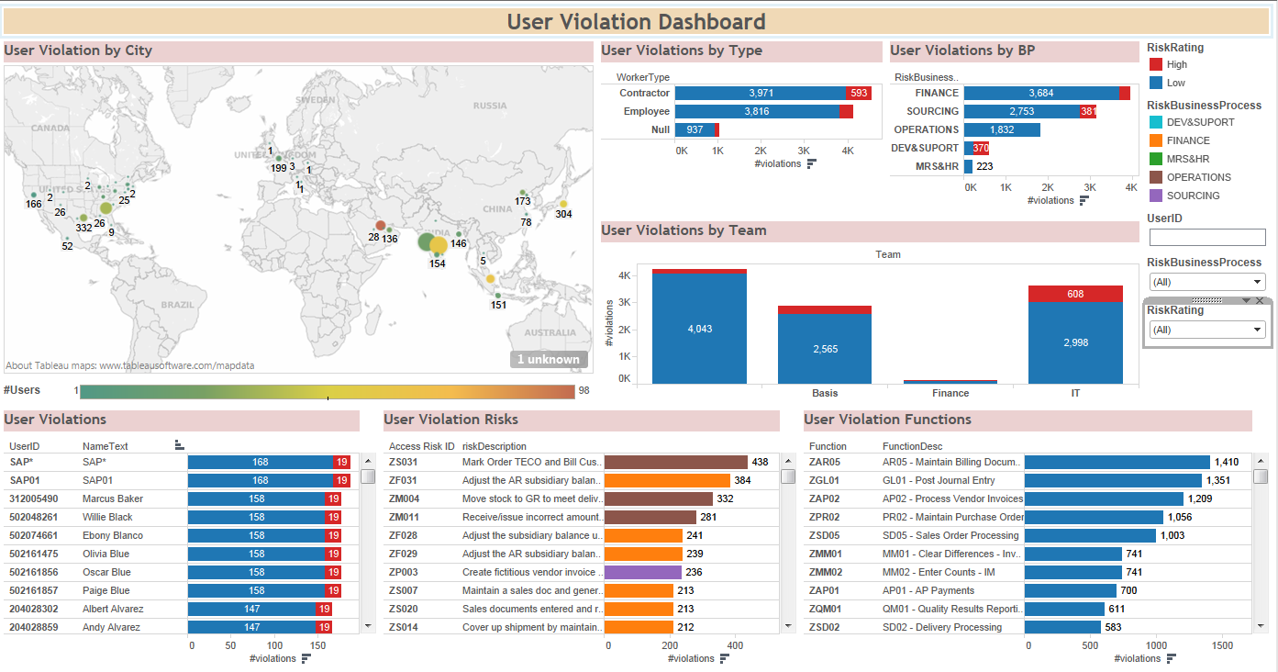
Interactive exercise #1 – Segregation of duties
What information can be retrieved from the dashboard above to assist in the audit testing?
Notes:
Time on slide: 5 minutes
Overall Elapsed Time: 61 minutes
Instructor Notes:
Say:
SOD risks relate to users who have conflicting roles that create a risk of material misstatement of financial statements
Different role combinations can present different levels of risk
Role combination risks can be broken down by various factors (geographic location, department, individual user, etc.)
Q&A:
Sample Answers
There is a higher user violation risk in Saudi Arabia than in other parts of the world for this company. Although India has a higher amount of users, the number of violations is not as high. Additionally, the Finance Dept seems to have more risks than other departments, possibly because finance deals more closely with financial statements.

Slide 28
Substantive testing
Substantive testing is an audit procedure that examines the balance sheets and other financial documentation to see if they contain errors. These tests are needed as evidence to support the assertion that the financial records of an entity are complete, valid, and accurate.
What are some of the risks that substantive testing addresses?
What are some of the benefits of using data analytics for substantive testing?
http://www.accountingtools.com/questions-and-answers/what-is-substantive-testing.html
Notes:
Time on slide: 2 minutes
Overall Elapsed Time: 63 minutes
Instructor Notes:
Say:
N/A
Do:
(After Q&A) Switch to next slide to display answers to the first question
Q&A:
Given the definition of substantive testing at the top of the slide, what do you think are some risks that are mitigated with substantive testing?

Slide 29
Substantive testing (continued)
Substantive testing is an audit procedure that examines the balance sheets and other financial documentation to see if they contain errors. These tests are needed as evidence to support the assertion that the financial records of an entity are complete, valid, and accurate.
What are some of the risks that substantive testing addresses?
Material misstatements in the financial statements, transactions and account balances.
Management override and financial statement fraud.
Material journal entries and other adjustments made during the preparation of the financial statements to go unnoticed.
What are some of the benefits of using data analytics for substantive testing?

Slide 30
Substantive testing (continued)
Substantive testing is an audit procedure that examines the balance sheets and other financial documentation to see if they contain errors. These tests are needed as evidence to support the assertion that the financial records of an entity are complete, valid, and accurate.
What are some of the risks that substantive testing addresses?
Material misstatements in the financial statements, transactions and account balances.
Management override and financial statement fraud.
Material journal entries and other adjustments made during the preparation of the financial statements to go unnoticed.
What are some of the benefits of using data analytics for substantive testing?
Allows to effectively identify accounts that may contain material misstatements in a timely manner.
Enables auditors to focus on a few key factors that affect the account balance.
Increases efficiency in performing understatement tests.

Slide 31
Application of analytics for substantive testing
The application of analytics for substantive testing includes, but is not limited to the following areas:
Journal Entry Testing
Source, manual/automated, trending, users activity, unusual and
common entries
Reconciliation
Summary system reports to raw data comparison, reserve study insurance triangles to source recon, multiple data source reconciliation, completeness & occurrence check
Substantive Testing
Reperformance
Repeating system key calculation activities, validation or business rules and testing client data process
Unstructured Text Analytics using OCR
Paper contracts to visual dashboards and PDF invoice reconciliation to GL
Notes:
Time on slide: 3 minutes
Overall Elapsed Time: 70 minutes
Instructor Notes:
Say:
These are some of the areas where analytics can be applied for substantive testing. The next few slides will talk more in-depth on examples.
Do:
Provide brief overview of each application area
Q&A:
N/A

Slide 32
Examples of analytics in substantive testing
Journal Entry Testing
High volumes of journals are utilized to identify the journals that might possess fraudulent activity. Given the high risk of management override, a health check should also be taken regarding the company’s audit procedures.
Reconciliation
Process of matching two independent sets of records. Client’s records against a third party’s records. Serves the assertions of completeness and existence/occurrence.
Reperformance
Evidence is obtained about client activities by repeating the activities and comparing the result with the client’s result.
Unstructured Text Analytics using OCR
Software that automatically analyzes printed text and converts it into a
structured format.
Please Note
All examples mentioned above with the exception of Journal
Entry Testing pertain to substantive testing in internal
audit as well.
Notes:
Time on slide: 5 minutes
Overall Elapsed Time: 75 minutes
Instructor Notes:
Say:
Journal Entry Testing
Unexpected Users - This test will return journals that have been created by users that are not expected to have created entries. The ‘find selected’ test can be used to identify the journals of specific users, or users not expected to create journals. Users can be combined with filtering to identify particular journals which should not be created by specific users.
Create and Approve test - This test identifies journals with one or more lines that are created and approved by the same creator ID or where there is no creator, no approver ID or neither
Duplicates and Reversals - This test identifies journals which are apparent duplicates or reversals of each other. The journals returned are presented in duplicate groups and reversal groups.
Reconciliation
Aggregated summarized system reports to raw source data comparison
Reserve study triangle reports to historical loss raw data for insurance companies
Reconciliation of reports from multiple data sources
Completeness & occurrence check
Reperformance
Repeating system key calculation activities: Key System report recalculations
Validation of business rules and testing client data process
OCR
Contract Analytics - Paper Scanned contracts to visual dashboards using tools like ABBYY (OCR technology tool)
PDF invoice reconciliation to GL
Additional Note:
Implemented programming structure can help automate much of the examples presented on slide. Complex calculations, repeatable tasks, and reporting can all be handled with automation. For Example Automating Interest Loan income calculation where same set of rules repeats every month or quarter to calculate monthly interests.
Q&A:
None

Slide 33
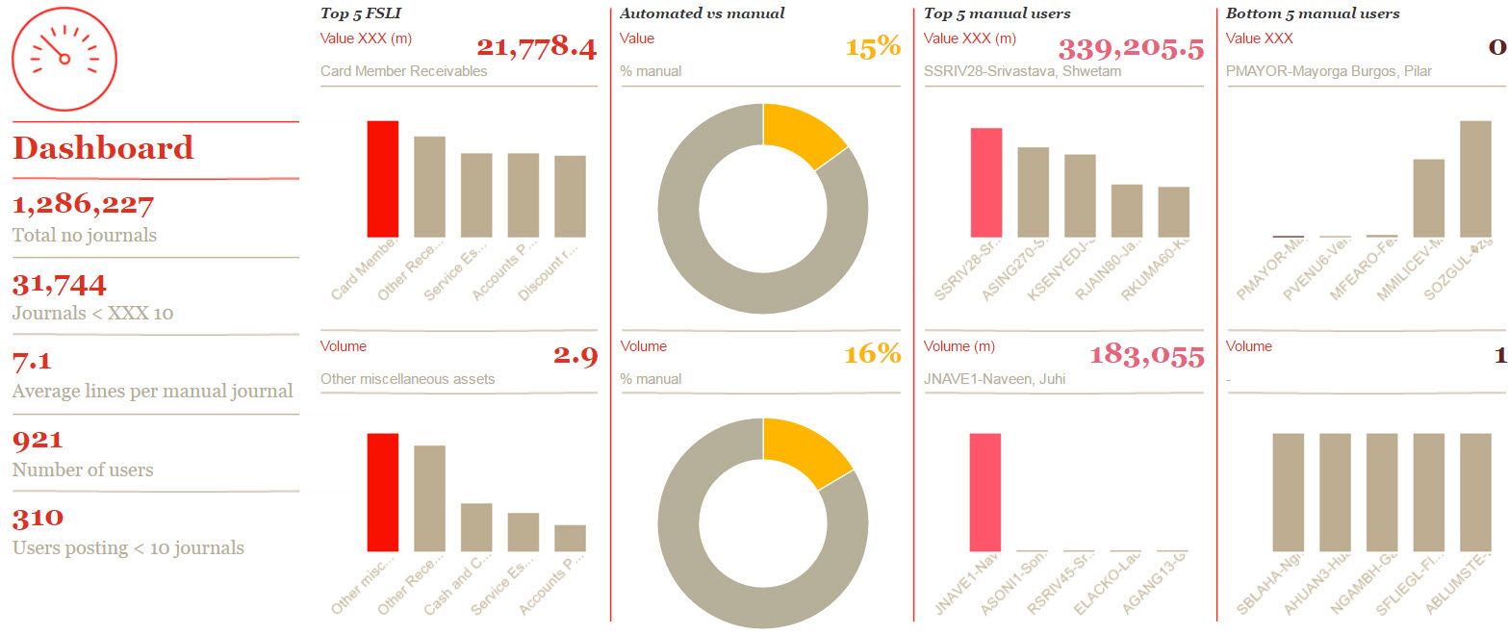
Example 1 – Journal entry visual analytics
Companies can have high volumes of journal entries so it can be difficult to identify the large and unusual journals by looking at millions of rows. Using visualization techniques on journals makes it easier to explore and visualise the data to identify high risk journals.
FSLI and User with highest GL activity
Notes:
Time on slide: 4 minutes
Overall Elapsed Time: 79 minutes
Instructor Notes:
Say:
Visualization tools can help provide further insight into data set. The dashboard displayed is used for journal entry testing, with charts identifying percentage of manually inputted entries vs. automated entries, users who posted the most manual entries, and more information.
Do:
N/A
Q&A:
N/A

Slide 34
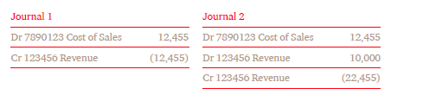
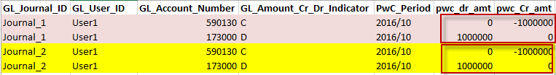
Example 2 – Journal entry – Duplicate journals
This test identifies journals which are apparent duplicates of each other.
A duplicate journal is defined as one having exactly the same net reporting amounts posted to exactly the same GL accounts in at least one other journal.
Each duplicate group will contain all the journals having a duplicate set of account net values.
Duplicate Journals with same net impact to the same GL Accounts
Sample 1
Sample 2
Samples above show two possible combination of journals which could be a potential duplicate of each other since they have exactly the same net reporting amounts posted to exactly same GL accounts, representing a heightened risk of fraud/error.
Notes:
Time on slide: 4 minutes
Overall Elapsed Time: 83 minutes
Instructor Notes:
Say:
Analytics can also assist in performing specific tests. For example, analytics can more efficiently identify potential duplicate journal entries that were posted to the general ledger.
Do:
N/A
Q&A:
What risk is presented by duplicate entries?
Sample answer: Duplicate entries can point to fraudulent or erroneous activity that can cause a material misstatement to financial statements.

Slide 35
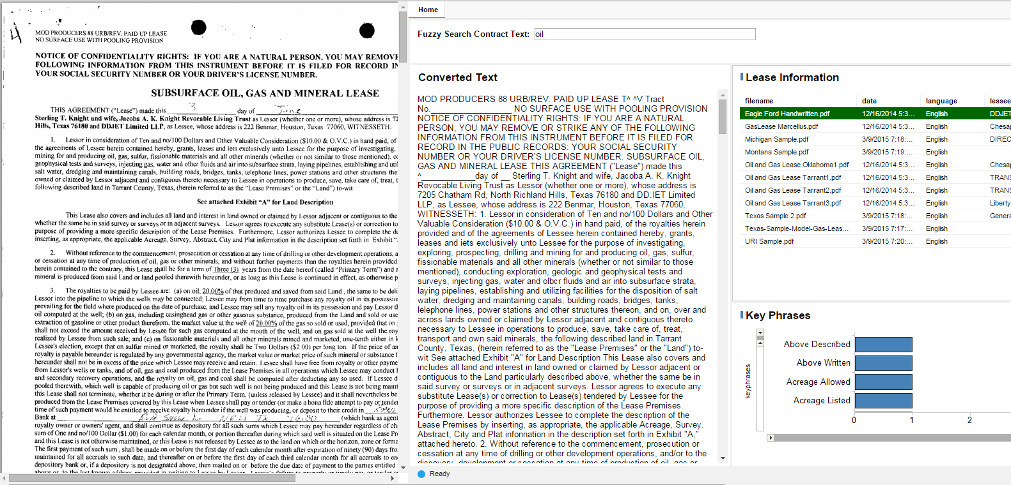
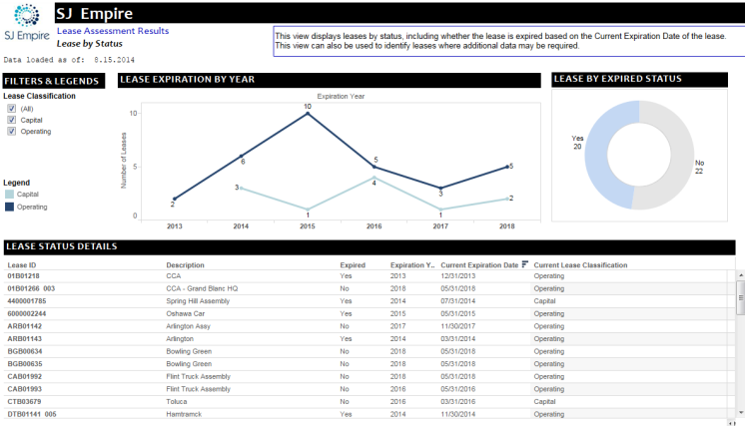
Example 3 – OCR in lease accounting
Challenge Overview
Lease information is trapped within physical documents or scanned contracts. Content discovery is labor intensive, and poor understanding of contractual elements may lead to compliance or financial issues.
The Solution
Using optical character recognition (OCR) and natural language processing, convert data within contracts into meaningful, actionable insights.
Capabilities
Add structure to unstructured sources
Search for and evaluate key data points within the appropriate context
Technology
OCR
Natural Language Processing
Machine Learning
Interactive Reporting
Data contained in PDFs and images
Key Data Points &
Relationships Extracted:
Common Phrases
Locations
Companies
Names
Converted text
Extracted content for validation
Interactive reporting and
key metrics
Notes:
Time on slide: 3 minutes
Overall Elapsed Time: 86 minutes
Instructor Notes:
Say:
OCR technology can assist in extracting relevant data from unstructured data. For example, scanned lease contracts can contain necessary information for reporting and analytics work. Without OCR technology, retrieving that information would be a long, manual process.
Do:
N/A
Q&A:
N/A

Slide 36
Check on learning – Multiple choice #1
What are the risks that substantive testing addresses?
Material misstatements in the financial statements, transactions and
account balances.
Management override and financial statement fraud
Material journal entries and other adjustments made during the preparation of the financial statements to go unnoticed.
I only
II & III
I,II,III
I & III
Notes:
Time on slide: 2 minutes
Overall Elapsed Time: 88 minutes
Instructor Notes:
Say:
N/A
Do:
N/A
Q&A:
N/A

Slide 37
Check on learning – Multiple choice #1 (Answer)
What are the risks that substantive testing addresses?
Material misstatements in the financial statements, transactions and
account balances.
Management override and financial statement fraud
Material journal entries and other adjustments made during the preparation of the financial statements to go unnoticed.
I,II,III
Notes:
Time on slide: 3 minutes
Overall Elapsed Time: 91 minutes
Instructor Notes:
Say:
Repeat that external audit deals with the risk of financial statement errors, which is why all three apply
Do:
N/A
Q&A:
N/A

Slide 38
Check on learning – Multiple choice #2
Company’s policy dictates that no employee is paid unless she has turned in a timesheet. The client states that this rule is in use for 100 percent of all paychecks. You can test this client assertion by taking a sample of payroll checks and matching them to the timesheets. Which technique of substantive testing would you apply to test it?
Completeness
Reconciliation
Reperformance
Journal Entry Testing
I
II
III
IV
Notes:
Time on slide: 2 minutes
Overall Elapsed Time: 93 minutes
Instructor Notes:
Say:
N/A
Do:
N/A
Q&A:
N/A

Slide 39
Check on learning – Multiple choice #2 (Answer)
Company’s policy dictates that no employee is paid unless she has turned in a timesheet. The client states that this rule is in use for 100 percent of all paychecks. You can test this client assertion by taking a sample of payroll checks and matching them to the timesheets. Which technique of substantive testing would you apply to test it?
Completeness
Reconciliation
Reperformance
Journal Entry Testing
III
Notes:
Time on slide: 3 minutes
Overall Elapsed Time: 96 minutes
Instructor Notes:
Say:
Repeat that external audit deals with the risk of financial statement errors, which is why all three apply
Do:
N/A
Q&A:
N/A

Slide 40
Risk assessment
Risk assessments should identify, quantify and prioritize tasks against criteria for risk acceptance and objectives relevant to the organization. The results should guide and determine the appropriate management action, priorities for managing information systems, and priorities for implementing controls selected to protect against these risks.
What are some areas that risk assessment addresses?
What are some of the benefits of using data analytics for risk assessment?
CISA Review Manual 2014
Notes:
Time on slide: 2 minutes
Overall Elapsed Time: 98 minutes
Instructor Notes:
Say:
N/A
Do:
(After Q&A) Switch to next slide to display answers to the first question
Q&A:
Given the definition of risk assessment at the top of the slide, what are some areas that risk assessment addresses?

Slide 41
Risk assessment
Risk assessments should identify, quantify and prioritize tasks against criteria for risk acceptance and objectives relevant to the organization. The results should guide and determine the appropriate management action, priorities for managing information systems, and priorities for implementing controls selected to protect against these risks.
What are some areas that risk assessment addresses?
Customers fulfilling payment obligations late or not at all.
Improper financial reporting of divisions or segments within a company.
Incomplete integration or separation of IT infrastructure when buying or selling business units.
What are some of the benefits of using data analytics for risk assessment?
Notes:
Time on slide: 2 minutes
Overall Elapsed Time: 100 minutes
Instructor Notes:
Say:
Risk assessment assists in identifying areas of high risk within financial reporting
Do:
(After Q&A) Switch to next slide to display answers to the second question
Q&A:
How can data analytics assist with risk assessment?

Slide 42
Risk assessment
Risk assessments should identify, quantify and prioritize tasks against criteria for risk acceptance and objectives relevant to the organization. The results should guide and determine the appropriate management action, priorities for managing information systems, and priorities for implementing controls selected to protect against these risks.
What are some areas that risk assessment addresses?
Customers fulfilling payment obligations late or not at all.
Improper financial reporting of divisions or segments within a company.
Incomplete integration or separation of IT infrastructure when buying or selling business units.
What are some of the benefits of using data analytics for risk assessment?
Relate the cost-benefit analysis of the control to the known risk, allowing
practical choices.
It helps to identify and target the higher risk areas that are relevant to the auditor.
Reduces or avoids the independence and familiarity of threats from external auditors.
Notes:
Time on slide: 2 minutes
Overall Elapsed Time: 102 minutes
Instructor Notes:
Say:
N/A
Do:
Tie back answers to the five pillars at start of presentation
Q&A:
N/A

Slide 43
Application of analytics for substantive testing
The application of analytics for substantive testing includes, but is not limited to the following areas:
Journal Entry Testing
Source, manual/automated, trending, users activity, unusual and
common entries
Reconciliation
Summary system reports to raw data comparison, reserve study insurance triangles to source recon, multiple data source reconciliation, completeness & occurrence check
Substantive Testing
Reperformance
Repeating system key calculation activities, validation or business rules and testing client data process
Unstructured Text Analytics using OCR
Paper contracts to visual dashboards and PDF invoice reconciliation to GL
Notes:
Time on slide: 3 minutes
Overall Elapsed Time: 70 minutes
Instructor Notes:
Say:
These are some of the areas where analytics can be applied for substantive testing. The next few slides will talk more in-depth on examples.
Do:
Provide brief overview of each application area
Q&A:
N/A

Slide 44
Application of analytics for risk assessment
The application of analytics for risk assessment includes, but is not limited to the following areas:
Accounts
Payable
Duplicate vendor/payment, one-time payments, restricted vendors,
lost accounts
Fraud, Waste,
& Abuse
Asset misappropriation, financial statement fraud
Risk Assessment
Carve-out (Partial Divestiture)
Financial statement reporting, IT infrastructure separation, allocation of assets and liabilities
Notes:
Time on slide: 3 minutes
Overall Elapsed Time: 105 minutes
Instructor Notes:
Say:
These are some of the areas where analytics can be applied for risk assessment. The next few slides will talk more in-depth on examples.
Do:
Provide brief overview of each application area
Q&A:
N/A

Slide 45
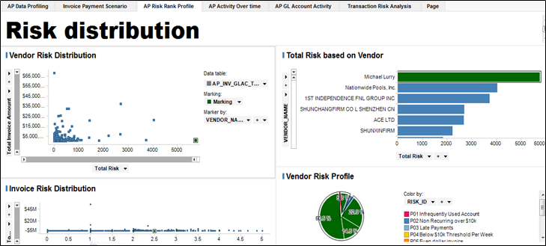
Example 1 – Accounts payable risk profiling
Accounts payable (AP) is prime example of analytics used in risk assessment. Identifying high risk profile vendors enables auditors to effectively determine potential fraudulent activity that can cause a material misstatement on financial statements. Such analysis can assist management plan and implement appropriate controls to address these risks.
Notes:
Time on slide: 3 minutes
Overall Elapsed Time: 108 minutes
Instructor Notes:
Say:
Account Payable analytics can help identify risky vendors. For businesses that deal with lots of vendors, this can help identify potential fraudulent activity that can impact financial statements.
Do:
Transition will show the red circles that highlight high risk profile vendors
Using various criteria to highlight which vendors have the highest risk profile
Q&A:
What can you identify from the “Vendor Risk Distribution” graph on the dashboard?
Sample Answer: Through analytics, we can quickly identify that certain vendors have a higher risk profile compared to others

Slide 46
Example 1 – Accounts payable risk profiling
Accounts payable (AP) is prime example of analytics used in risk assessment. Identifying high risk profile vendors enables auditors to effectively determine potential fraudulent activity that can cause a material misstatement on financial statements. Such analysis can assist management plan and implement appropriate controls to address these risks.
High risk profile vendors
Notes:
Time on slide: 2 minutes
Overall Elapsed Time: 110 minutes
Instructor Notes:
Say:
You can use certain criteria to identify whether some vendors carry more risk than others.
Do:
N/A
Q&A:
N/A

Slide 47
Example 2 – Carve-out – Financial reporting
A carve-out is the process of divesting a struggling or non-core segment of the business from the parent company. A carved-out segment must have it’s own complete, independent financial statement reporting, as well as proper separation of the IT infrastructure.
The following is a process map of a carve-out financial reporting test:
1
2
3
Data Acquisition
Preparation and Loading
Completeness and Accuracy
Collect the data that is necessary to ensure appropriate financial statement reporting at more granular level
Assess whether data is structured in a format that can be stored easily and load data into a database management system
Check whether the loaded data is complete and accurate prior to proceeding with testing
4
5
6
Data Manipulation
Reconciliation
Results
Extract the subset of data that is associated with the segment of the firm that is being carved out/sold off.
Perform reconciliation of the data subset to identify if the financials of the carve-out segment are being reported correctly
Communicate the results and determine if any follow-ups are required
https://www.aira.org/pdf/journal/december-january-2012.pdf
Notes:
Time on slide: 4 minutes
Overall Elapsed Time: 114 minutes
Instructor Notes:
Say:
This is the general structure of data analytics support for a carve-out financial statement reporting. Of course, given the nature of the carve-out, the type of analytics support provided can differ.
Segments within a company are often times distinguished by certain criteria, such as a business unit or product category, which can be used as filtering criteria in the data
If there are variances, ensure that data received was correct.
Do:
N/A
Q&A:
N/A

Slide 48
Check on learning – Multiple choice #3
What is a benefit of using data analytics for risk assessment?
It helps to identify and target the higher risk areas that are relevant to the auditor.
Data analytics prove who should be charged with fraud
Data analytics are not specifically beneficial to risk assessment
Notes:
Time on slide: 2 minutes
Overall Elapsed Time: 116 minutes
Instructor Notes:
Say:
N/A
Do:
N/A
Q&A:
N/A

Slide 49
Check on learning – Multiple choice #3 (Answer)
What is a benefit of using data analytics for risk assessment?
It helps to identify and target the higher risk areas that are relevant to the auditor.
Notes:
Time on slide: 3 minutes
Overall Elapsed Time: 119 minutes
Instructor Notes:
Say:
N/A
Do:
N/A
Q&A:
N/A

Slide 50
Check on learning – Scenario #3
While looking at a ticketing tool for a financial institution, an auditor noticed that a staff member approved a supervisor’s request for access to a certain application. The supervisor needed access to the application in order to complete his work. The approval allowed the supervisor to have access and to use the application freely.
Question 1: What type of internal control is in place to make sure that each user is approved for a new application?
Question 2: Did the financial institution properly follow the internal controls that are in place?
Question 3: If not, what did the financial institution do wrong?
Notes:
Time on slide: 5 minutes
Overall Elapsed Time: 124 minutes
Instructor Notes:
Say:
N/A
Do:
N/A
Q&A:
Sample Answers
There are IT General Controls in place to make sure that appropriate management approves each user
No, the bank did not follow the ITGC
The approval was improper since appropriate management did not approve access to the supervisor.

Slide 51
Check on learning – Multiple choice #4
Lyons & Lyons CPAs are in the midst of their audit of Main Street, Inc. and are concerned about a transaction that appears to be fraudulent. How should Lyons & Lyons react?
They should maintain their planned approach to the audit.
They should plan inventory observations further in advance with the company.
They should reflect their concerns in the working papers and move on to
something else.
They should review adjusting entries in detail.
Auditor’s Response to the Fraud Risk Assessment,
Notes:
Time on slide: 2 minutes
Overall Elapsed Time: 126 minutes
Instructor Notes:
Say:
N/A
Do:
N/A
Q&A:
N/A

Slide 52
Check on learning – Multiple choice #4 (Answer)
Lyons & Lyons CPAs are in the midst of their audit of Main Street, Inc. and are concerned about a transaction that appears to be fraudulent. How should Lyons & Lyons react?
They should review adjusting entries in detail.
Notes:
Time on slide: 3 minutes
Overall Elapsed Time: 129 minutes
Instructor Notes:
Say:
N/A
Do:
N/A
Q&A:
N/A

Slide 53
Case study
Data analytics is the art and science of discovering and analyzing patterns, identifying anomalies, and extracting other useful information in data underlying or related to the subject matter of an audit through analysis, modeling, and visualization for the purpose of planning or performing the audit
Reference hand-out
https://www.aicpa.org/InterestAreas/FRC/AssuranceAdvisoryServices/DownloadableDocuments/AuditAnalytics_Looking
TowardFuture.pdf
Notes:
Time on slide: 3 minutes
Overall Elapsed Time: 132 minutes
Instructor Notes:
Say:
N/A
Do:
Hand out “Case Study - On the Go Stores (Student Copy Part 1 of 2)_FINAL” first
After going through the first part, hand out the second part found in “Case Study - On the Go Stores (Student Copy Part 2 of 2)_FINAL”
Q&A:
N/A

Slide 54
Learning objectives
At the end of this case study, students will be able to:
Identify potential fraud and other risks through utilizing analytics tools
Notes:
Time on slide: 45 minutes
Overall Elapsed Time: 177 minutes
Instructor Notes:
Say:
The learning objective for the case study is to understand how to assess possible fraud and other risks through utilizing analytics tools.
Do:
Pause on this slide and instruct students to complete the first part of the case study. Reconvene and discuss the answers for the first set of questions.
After the first part is completed, hand out the second part of the case study. Reconvene and discuss the answers for the second set of questions.
Q&A:
N/A

Slide 55
Questions?
Notes:
Time on slide: 3 minutes
Overall Elapsed Time: 180 minutes
Instructor Notes:
Say:
Thank you for participating in the Data Analytics in the Audit course. Does anyone have any questions?
Do:
N/A
Q&A:
N/A

Slide 56
Key points
What are potential advantages of using analytics in an audit?
What are considerations in selecting an opportunity to use analytics in an audit?
What are major audit areas where analytics can be applied?
What risks are addressed by substantive testing?
What kinds of substantive testing can be performed with analytics?

Slide 57
© 2018 PwC. All rights reserved. PwC refers to the US member firm or one of its subsidiaries or affiliates, and may sometimes refer to the PwC network. Each member firm is a separate legal entity. Please see www.pwc.com/structure for further details

