Slide 1
Statistical Programming II
www.pwc.com

Slide 2
Review

Slide 3
Data analysis cycle
5
1
Present findings
Ask a question
4
2
Analyze data
Acquire data
3
Transform data

Slide 4
Readings

Slide 5
Discussion
“Research Ideas for Artificial Intelligence in Auditing” (Journal of Emerging Technologies in Accounting):
What were some of the research questions identified by the authors?
What are some of the challenges for AI in the audit context?
How would you propose to address them?
What role do standards play in the adoption of new technologies?
What is the likelihood that AI disrupts the profession? Do you agree?
“A.I. Is Harder Than You Think” (New York Times):
What do the authors say about challenges to progress in A.I.?
What do you think will happen in the field?

Slide 6
AI in the audit?
Phase | Traditional Process | AI-Enabled Process
Pre-planning | Auditor examines client’s industry; Auditor examines client’s organizational structure, operational methods, and accounting and financial systems | AI collects and analyzes Big Data (exogenous); Data related to the client’s organizational structure, operational methods, and accounting and financial systems feed into AI system
Contracting | Engagement letter prepared by the auditor based on the estimated client risk; Auditor and client sign contract | AI uses the estimate of the risk level (from Phase 1) and calculates audit fees and the number of hours; AI analyzes a database of contracts and prepares the contract; Auditor and client sign contract
Understanding internal controls and identifying risk factors | Document understanding (flowcharts, questionnaires, narratives, walkthrough); Auditor aggregates this information and uses their judgment to identify risks factors; Understanding of IC to determine the scope, nature, and timing of substantive tests | Feed flowcharts, questionnaire answers, and narratives into the AI system and use image recognition and text mining to analyze them; Use drones to conduct the walkthrough, then use AI to analyze the generated video; Use visualization and pattern recognition to identify risk factors; AI aggregates all these data to identify fraud and illegal-acts risk factors
Control risk assessment | Examination of the client’s IC policies and procedures; Risk assessment for each attribute; Test of controls; Risk reassessment; Document testing of controls | Continuous control monitoring systems examine controls continuously; AI runs process mining to verify proper IC implementation; Logs are automatically generated to ensure their integrity
Substantive tests | Periodical sampling-based tests, and nature, extent, and timing depend on IC tests; Tests of details of a sample of transactions; Test of details of balances (at a certain point in time); Analytical procedures | Continuous Data Quality Assurance ensures quality of data and evidence; AI examines data provenance; Continuous test of details of transactions on 100% of the population; Continuous test of details of balances (at all times); Continuous pattern recognition, outlier detection, benchmarks, and visualization
Evaluation of evidence | Auditor must evaluate the sufficiency, clarity, and acceptability of collected evidence; Accordingly, auditor may either collect more evidence, or withdraw from engagement | This becomes part of the previous phase
Audit report | Auditor aggregates previous information to issue a report; Report is categorical: clean, qualified, adverse, etc. | AI uses a predictive model to estimate the various risks identified; Audit report can be continuous (graded 1–00 for example) rather than categorical (clean, qualified, adverse, etc.)
Source: “Research Ideas for Artificial Intelligence in Auditing” (Journal of Emerging Technologies in Accounting)

Slide 7
Model development

Slide 8
Model development process
7
1
Ongoing Evaluation
Requirements Assessment
6
2
Model Deployment
Data Profiling & Integration
5
3
Model Evaluation
Data Preparation
4
Model Selection
Notes:
Engage stakeholders to understand levels of escalation and investigative procedures; define model populations and level of escalation/productivity to be modeled
Identify and obtain data sources for historical outcomes and predictive attributes; perform data quality assessment and initial data profiling; address data quality issues
Derive attributes based on fraud indicators, test taker/admin/center traits, and activity patterns that may be correlated with productivity
Split historical data into training and validation sets;
select machine learning algorithms to determine a combination of attributes with a high correlation to productivity and assign weights to the attributes
Evaluate predictive power of model with statistical measures; evaluate consistency of model performance on validation sets; refine model by removing or adding attributes as appropriate
Put machine learning model into operation by scoring alerts in production; determine procedures for utilizing alert scores
Perform model evaluation on an ongoing basis using productivity data from production alerts; identify new potential model attributes through random sampling and pattern analysis

Slide 9
Requirements assessment
What question are we answering?
How will the predictive model be used?
What are we trying to predict?
What data do we have?
What data can we get?
What data might help us make good predictions?

Slide 10


Data profiling & integration
Predictive models are only as good as the data and derived variables used to build the model
Model development may require data integration from multiple sources
Databases
Applications
Documents
Open data
Social media
Data quality assessment is critical to address potential weaknesses and understand the limitations of a model
Garbage in, garbage out!
Gold in, gold out!

Slide 11


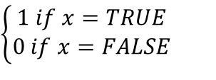

Data preparation
Models often rely on derivations or calculations of new variables or “features” from source data to capture variation in the dependent variable
Exponents and logarithms change the functional form of the model from linear
to nonlinear
Additional approaches for new variable creation or “feature engineering” include:
Dummy variables
Interactions
Date-time values
Aggregation
Frequency
Keyword flags
Sample Transformations
$$x^{2}$$
$$log(x)$$
x
$$\left\{\begin{aligned}1 if x=TRUE \\ 0 if x=FALSE\end{aligned}\right.$$
$$x ∗z$$

Slide 12
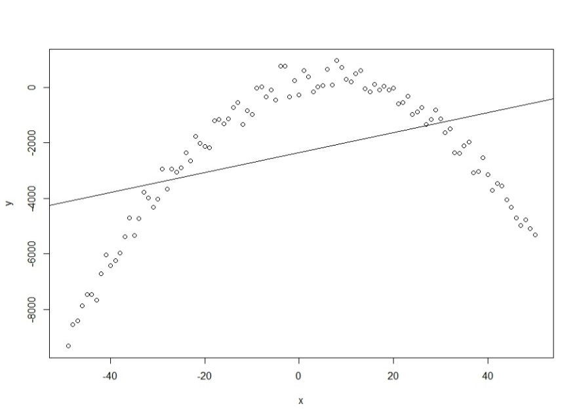
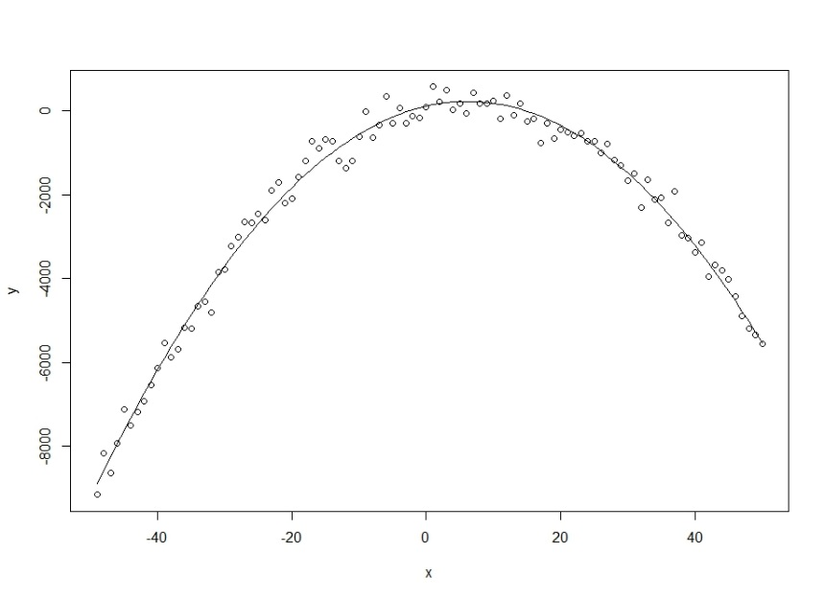


Quadratic term
$$y= β_{0}+ β_{1}x$$
$$y= β_{0}+ β_{1}x−β_{2}x^{2}$$
Simple linear model fails to account for decreasing marginal effect
Quadratic term produces curve instead of straight line

Slide 13
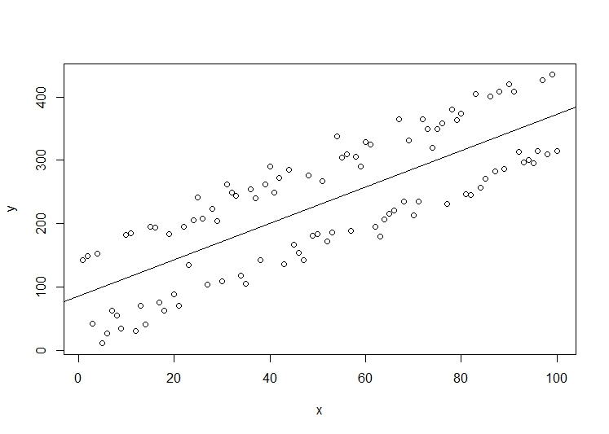
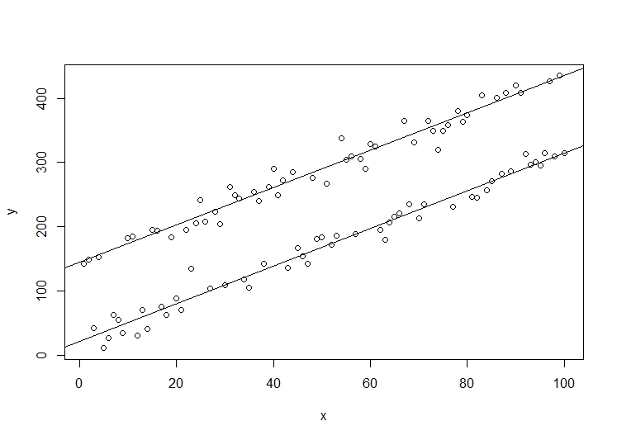

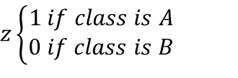

Dummy variables
$$y= β_{0}+β_{1}x$$
$y= β_{0}+ β_{1}x−β_{2}$z
Simple linear model fails to capture separate processes for different observations
z is a dummy variable representing the state of the observation
$$z\left\{\begin{aligned}1 if class is A \\ 0 if class is B\end{aligned}\right.$$

Slide 14
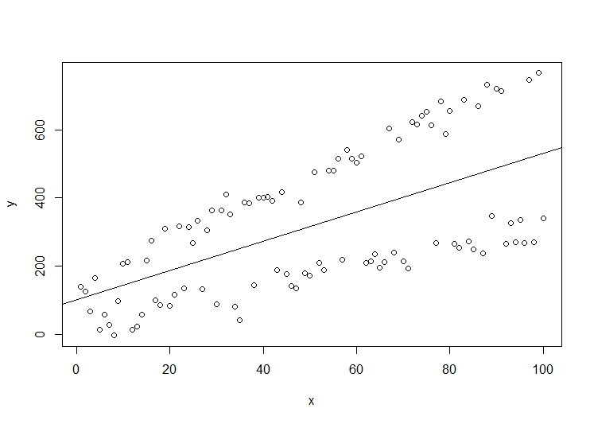
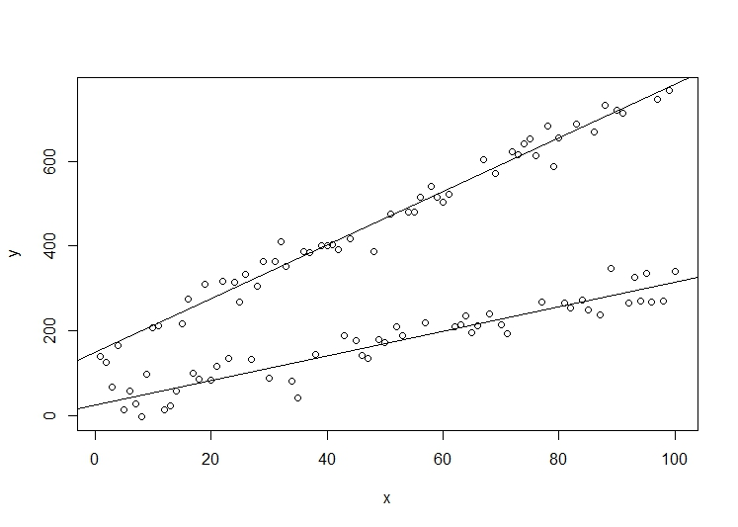

Interactions
$$y= β_{0}+β_{1}x$$
$$y= β_0+β_1 x+β_2 z+β_3 xz$$
Simple linear model fails to capture separate processes for different observations
z is a dummy variable representing the category of the observation
... and xz is the product of two different variables, x and z

Slide 15
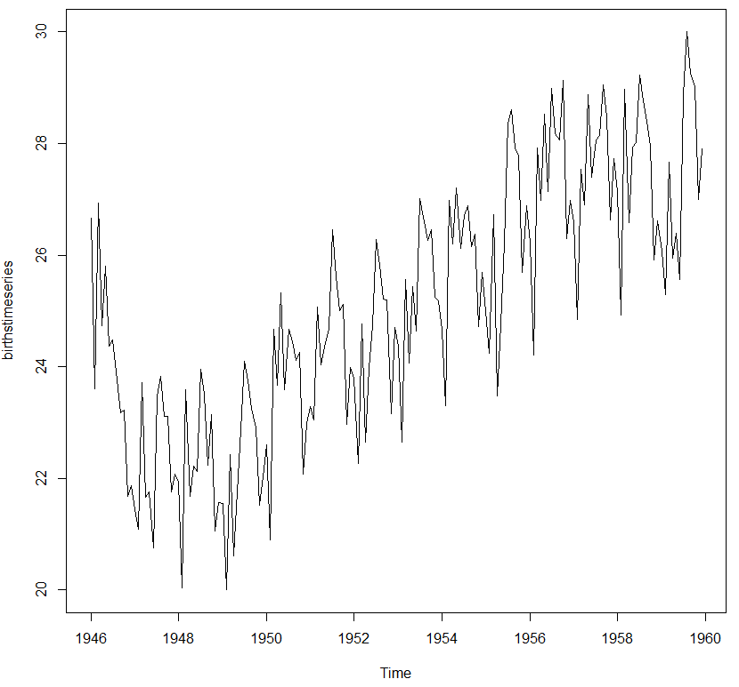
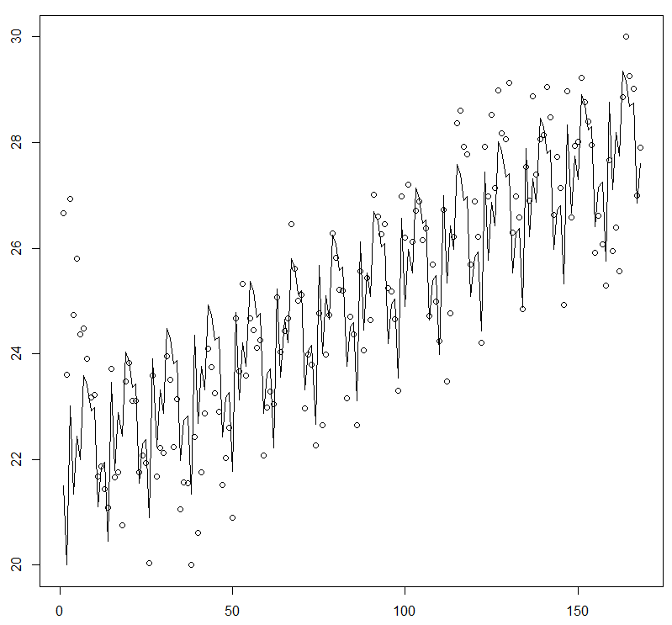
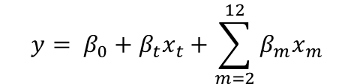
Trend and seasonality
Trend and seasonality
Trend term
Dummy variables for each month
$$y= β_{0}+β_{t}x_{t}+\sum_{m=2}^{12}{β_{m}x_{m}}$$
Monthly time series displays increase over time and regular fluctuations
Linear model reflects trend and monthly effects
Notes:
http://a-little-book-of-r-for-time-series.readthedocs.io/en/latest/src/timeseries.html

Slide 16
Model selection
Model selection involves methodological and practical considerations
Is this regression or classification?
Do we have data for a single period or multiple periods?
How important is interpretability?
How much data do we have?
How can we address missing values?
What are potential limitations on implementation?

Slide 17
Model evaluation
We also evaluate models from statistical and business perspectives
What is the statistical significance of the independent (X) variables?
Do the weights assigned to the independent variables make sense?
For regression:
What is the overall error between predicted and actual values?
Do the errors indicate systematic issues with the model?
For classification:
What are the rates of false positive and false negatives?
What is the cost of a false positive or false negative?
What is the right threshold?
Notes:
Predictive modeling encompasses a wide range of techniques, but the most familiar is probably linear regression. Here we are trying to predict a continuous variable, e.g. using years of education to predict wages.
A univariate or single-variable regression model involves exactly one independent variable and one dependent variable (plus a constant), while a multivariate model can have an arbitrary number of independent variables.
The scatter plot with a line of predicted values should be familiar.

Slide 18
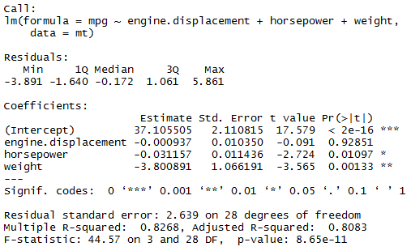
Model evaluation – Regression
Model results include the sign and magnitude of the estimated coefficients for each variable
A low p-value indicates that an independent variable is statistically significant
The “R squared” value is a measure of the “goodness of fit” of the model based on the differences between actual and predicted values
Adjusted R squared introduces a
penalty for variables that are not statistically significant
Coefficients
p-values
Adjusted R squared

Slide 19
Model evaluation – Classification
A common starting point for classification model evaluation is a confusion matrix that compares model predictions to actual results
Determining an appropriate threshold for classification generally depends on the costs of false positives and negatives
Confusion Matrix: Fraud Detection
 | Fraud did not occur | Fraud did occur
Model predicts fraud | False positive (Type I Error) | True positive
Model predicts no fraud | True negative | False negative (Type II Error)
Threshold?
Fraud did not occur
Fraud did occur
Distribution of predicted value
False negative
False positive

Slide 20
Training, validation, and test sets
Evaluating out-of-sample performance can prevent overfitting and indicate whether the model will generate effective predictions for new data
Split sample data into training, validation, and test sets instead of training a model on the complete data set
Training set: Estimate the model and examine model statistics
Validation set: Generate predicted values and evaluate candidate model performance to identify opportunities for improvement
Test set: Generate predicted values and report final model performance
Consider cross-validation using multiple splits of the data

Slide 21
Model deployment & ongoing evaluation
Once stakeholders approve a satisfactory model, the model can be deployed:
Implemented in an environment with access to production data
Front-end management and/or reporting
Recommendations for potential enhancements and model refreshes
A model can also be retrained on new data automatically
Model development and deployment is a fundamentally iterative process where new data can lead to:
Changes in variable weights
Changes in variable significance
Opportunities to derive new variables
Increasing or decreasing model performance

Slide 22
Discussion
“The Detection of Earnings Manipulation” (Beneish):
What did you think of the earnings management model described in the paper?
What question was he trying to answer?
What data did he use?
What was the dependent variable? Independent variables?
What type of model did he select?
How did the model perform?

Slide 23
Linear regression

Slide 24

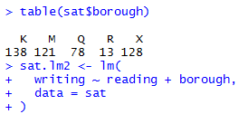
Linear regression – lm()
Arguments
formula: symbolic description of model to be defined using tilde (~) to separate dependent variable from independent variables
data: data frame to be used for regression
subset: optional vector used to specify if a subset of observations are to be used for the fitting process
na.action: a function to indicate how to deal with NA values
Output
coefficients: vector for coefficients of the input in formula
residuals: numeric vector to indicate residuals for each data point
fitted.values: numeric vector to indicate fitted mean values for each data point
df.residual: indicates the residual degrees of freedom

Slide 25
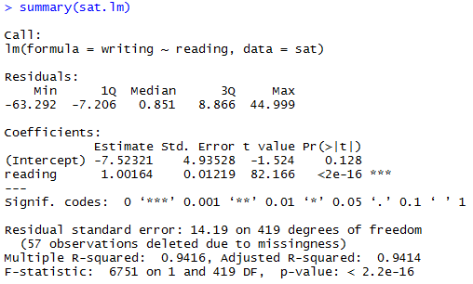
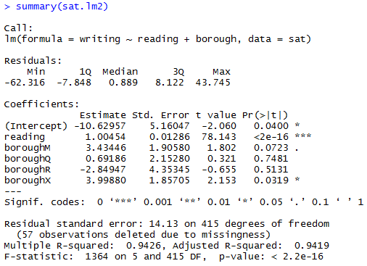
Linear model outputs
summary() displays the results of a linear model
Univariate model
Multivariate model
p values indicate statistical significance
Adjusted R-squared value indicates goodness of fit
These results are “pretty printed” but the return value of summary() includes many additional statistics
Notes:
Here we also see the p-values and the R-squared values. In this case, we strongly reject the idea that the reading score is not related to the writing score, while we find little evidence that the school’s borough has anything to do with it.
The predict() function can be used with the original values or new data.

Slide 26
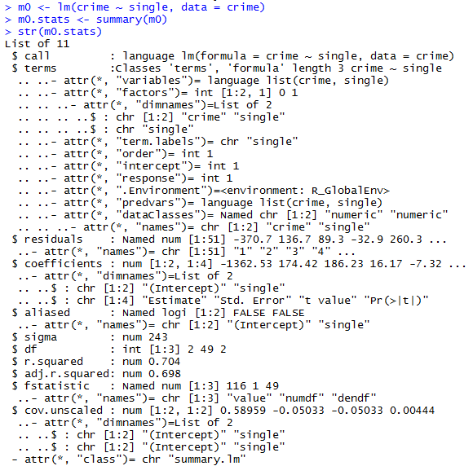
Linear model outputs (continued)
str() reveals the complete list structure of the object returned by summary() and lm()
Key statistics include:
coefficients
t statistics
p values
R-squared
Adjusted R-squared
Degrees of freedom

Slide 27
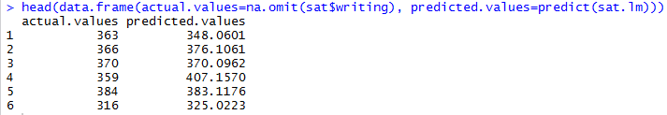
Linear model outputs (continued)
Additional functions extract statistics from the model:
resid(): return residuals
fitted.values(): return predicted values for the training data
AIC(): Aikake information criterion (goodness of fit)
predict() applies the model to new data

Slide 28
Exercise #1
Load wine and baseball from the.RData file.
Estimate a series of models to predict the quality score of a wine using different combinations of independent variables. Identify the best model. Be prepared to describe the overall quality, variables, and limitations of your chosen model.

Slide 29
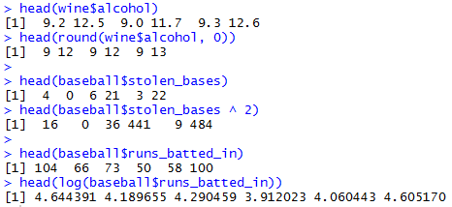

Numeric functions
Various functions are used to transform numeric values:
round()
^ or ** (exponent)
log()
sqrt()
abs()
scale()
A conditional operator used with a column returns a new logical vector that can be further transformed into a binary vector with as.integer():

Slide 30
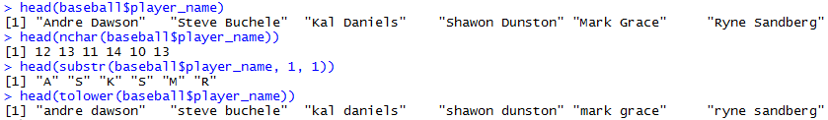
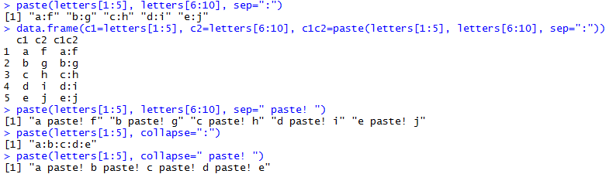
Text functions
nchar(): Takes a character vector and returns the length of vector
substr(): Extracts or replaces substrings by position
toupper()/tolower(): Change all characters to upper or lower case
paste(): concatenates vectors pairwise or collapses a vector into a single string

Slide 31
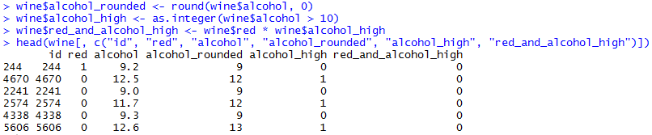
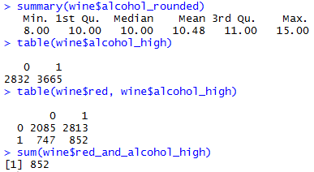
Deriving new columns
Transform or combine existing columns in a data frame and assign the value to a new column name
Use summary(), table(), and other statistical functions to profile new columns:

Slide 32



Sampling
The sample() function can create an index to use for sampling elements from a vector or rows from a data frame
x: Vector of elements from which to choose or a positive integer; if an integer is given, the range from 1 to the integer
size: Number of items to choose
replace: Should sampling be with replacement?
sample() can also be used to split a data frame into training and validation data sets
The separate function set.seed() enables reproducible sampling

Slide 33
Exercise #2
Split the baseball data frame into a training set with 75% of the rows and a validation set with the remaining 25% of the rows.
Estimate a series of models to predict a baseball player’s salary using different combinations of independent variables, including newly derived columns. Identify the best model. Be prepared to describe the overall quality, variables, and limitations of your chosen model.

Slide 34
Logistic regression

Slide 35

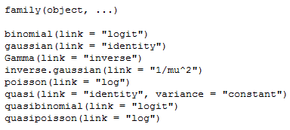
Logistic regression – glm()
Arguments:
formula: Symbolic description of model to be defined
data: Data frame to be used for regression
family: The function (nonlinear transformation) to be used, e.g. “binomial” for logistic regression
Output:
coefficients: vector for coefficients of the input in formula
residuals: numeric vector to indicate residuals for each data point
fitted.values: numeric vector to indicate fitted mean values for each data point
aic: returns the AIC value for the model
glm family Argument

Slide 36
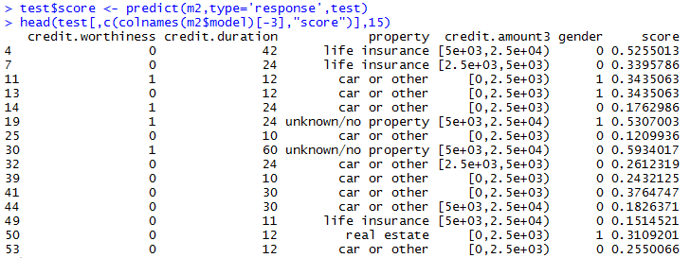
Logistic model output
Because the model equation for logistic regression has been transformed,
predict() requires an additional argument to return the fitted or response values

Slide 37
Logistic regression evaluation
Predicted values are the probability of the event, so the overall quality of the model is judged by the rates of:
True and false positives
True and false negatives

Slide 38
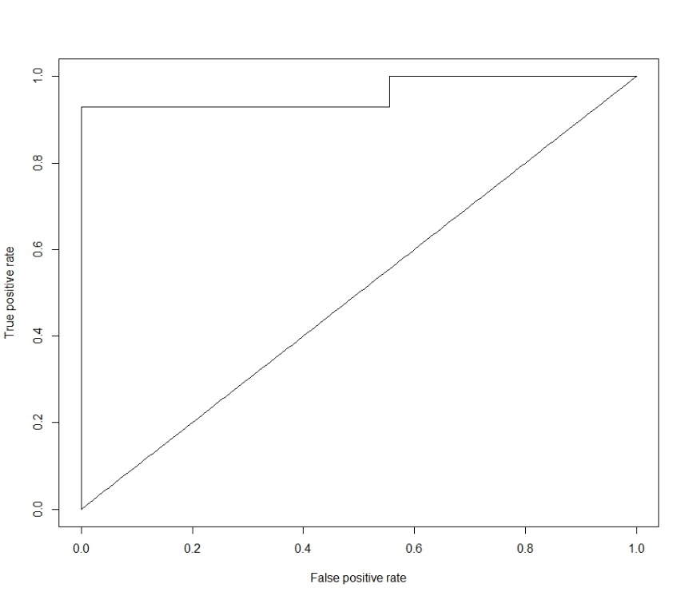
Logistic regression evaluation (continued)
The Receiver Operating Characteristic (ROC) curve shows the false positive rate against the true positive rate at different thresholds
The Area Under the Curve (AUC) is the probability that a random positive event has a higher predicted value than a random negative event
ROC Curve
AUC = 0.96
Optimal tradeoff between TP and TN

Slide 39
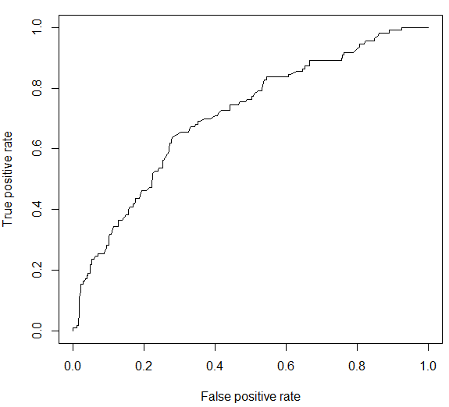
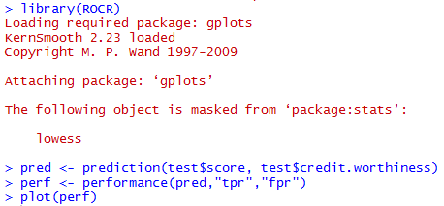
Logistic regression evaluation (continued)
The ROCR package enables creation of ROC curves using intermediate functions
prediction()
performance()

Slide 40
Exercise #3
Split the wine data frame into a training set with 75% of the rows and a validation set with the remaining 25% of the rows.
Estimate a series of logistic regression models to classify a wine as red or white using different combinations of independent variables. Identify the best model. Be prepared to describe the overall quality, variables, and limitations of your chosen model.

Slide 41
Summary

Slide 42
Acquire data
Task | Description | R
Data access | Connect to a data source | setwd() list.files()
Importing data | Read the data into an analytical environment | read.table() readLines() readxl load()
Data profiling | Review data dimensions and summary statistics | str() dim(), nrow(), ncol() summary() unique()
Data quality assessment | Identify aspects of the data that pose challenges for subsequent analysis | is.na()
Data simulation | Generate data based on analytical requirements | sample()

Slide 43
Transform data
Task | Description | R
Cleaning data | Address data quality issues to facilitate analysis | gsub() tolower(), toupper() Stringr
Changing data types | Convert a value to the appropriate format for analysis | as.character(), as.numeric(), etc.
Filtering data | Create subsets of records and features based on specified conditions | conditional operators Sqldf
Deriving data | Create new features from original features | assignment operators Sqldf
Scaling data | Put features with different ranges of values on the same scale while preserving relative values | scale()
Notes:
Data wrangling, munging, preparation…

Slide 44
Transform data
Task | Description | R
Sampling data | Create subsets of records based on a probability distribution | sample()
Aggregating data | Return a statistic or value for one feature according to different values of another feature | aggregate() sqldf
Reshaping data | Change whether values are represented in different records or different features | reshape()
Concatenating data | Combine data sets through juxtaposition | rbind() cbind()
Merging data | Combine data sets by matching records on a common identifier | merge() sqldf
Notes:
Data wrangling, munging, preparation…

Slide 45
Analyze data
Task | Description | R
Summary analysis | Calculate representative statistics for features of interest | summary() min(), max(), mean(), etc.
Perform statistical tests | Estimate the probability that the data supports a specific claim | t.test() prop.test()
Clustering | Identify similar groups of records | kmeans()
Predictive modeling | Use one set of features to predict the value of another feature | lm() glm() predict() nnet rpart
Network analysis | Examine relationships between entities | igraph

Slide 46
Present findings
Task | Description | R
Data visualization | Display data using lines, shapes, colors, and other abstract representations | plot() barplot boxplot()
Dashboarding | Create a collection of dynamic visualizations | shiny
Exporting data | Produce output from an analytical environment for future use | write.table() writeLines() save()
Make recommendations | Use results of data analysis to guide decision-making

Slide 47
Appendix

Slide 48
Exercise #1
Create scatter plots of the “Four Data Sets” using par (mfrow = c(2, 2)) to display four plots at the same time.
Use par (mfrow = c(1, 1)) to return to the default display of one plot at a time.

Slide 49
“Anscombe’s Quartet”
Property | Value | Accuracy
Mean of x | 9 | exact
Sample variance of x | 11 | exact
Mean of y | 7.5 | 2 decimal places
Sample variance of y | 4.125 | plus/minus 0.003
Correlation between x and y | 0.816 | 3 decimal places
Linear regression line | y = 3.00 + 0.500x | 2-3 decimal places

Slide 50
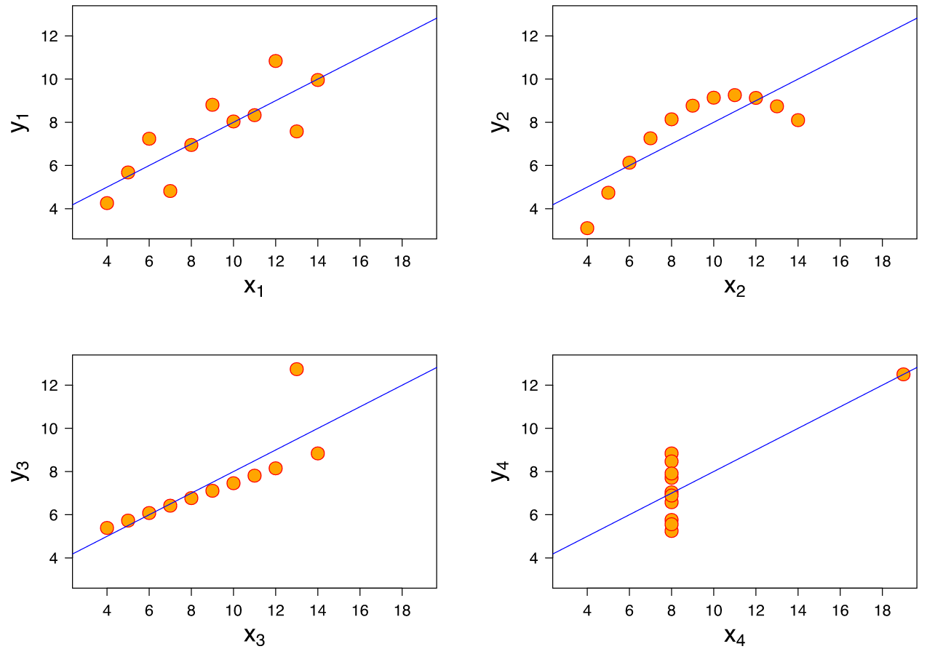
Visualizing the quartet

Slide 51
© 2018 PwC. All rights reserved. PwC refers to the US member firm or one of its subsidiaries or affiliates, and may sometimes refer to the PwC network. Each member firm is a separate legal entity. Please see www.pwc.com/structure for further details.

