Slide 1
Relational Databases and SQL
www.pwc.com

Slide 2
Class objectives
Demonstrate knowledge of relational databases, data lineage, and ERP systems
Demonstrate how to interpret an entity relationship diagram
Demonstrate how to use SQL to transform and analyze data

Slide 3
Review

Slide 4
Data analytics process
5
1
Present findings
Ask a question
4
2
Analyze data
Acquire data
3
Transform data

Slide 5
Relational databases

Slide 6
What is a relational database?
A relational database is a collection of data that organizes data in tables and maintains relationships between the tables for information retrieval
A relational database management system (RDBMS) is computer software that enables users to create, modify, and analyze data in a relational database
Enterprise RDBMS include:
Microsoft SQL Server
Oracle Database
Oracle MySQL
IBM DB2
SAP Sybase
Teradata
PostgreSQL
Lightweight RDBMS include:
Microsoft Access
SQLite

Slide 7
Key terms
A table is the basic unit of data storage in a database. Data is stored in rows and columns. You can specify rules for each column of a table like establishing its data type, forcing a column to contain a value in every row, or ensuring unique records
A view is a tailored presentation of data selected from one or more tables, possibly including other views. A view contains no actual data but rather derives what it shows from the tables and views on which it is based. Therefore, a view can be thought of as a virtual table
A schema is a “container” within a database similar to a directory on a file system that groups tables together
The connection between tables is made by a Primary Key – Foreign Key pair, where the Foreign Key in a table is the Primary Key of another table
A query is used to create, manipulate, or view database objects
A report is formatted view of data from the database within user-defined parameters, often generated in an external file format such as.txt

Slide 8
Tables
Tables consist of 0ne or more records or rows of data
The data for each row is organized into a defined set of attributes, organized into columns
Data types include:
String/Text/Character
Numeric (Integer, Float)
Date/Time
Boolean (Yes/No, True/False)
CustomerID | CompanyName | Contact Name | ContactTitle
GREAL | Great Lakes Food Market | Howard Snyder | Marketing Manager
HUNGC | Hungry Coyote Import Store | Yoshi Latimer | Sales Representative
LAZYK | Lazy K Kountry Store | John Steel | Marketing Manager
LETSS | Let's Stop N Shop | Jaime Yorres | Owner
LONEP | Lonesome Pine Restaurant | Fran Wilson | Sales Manager

Slide 9
Relational tables
Primary Key
Customers
Foreign Key
CustID | FirstName | LastName | Email
1 | John | Smith | John.Smith@yahoo.com
2 | Steven | Goldfish | goldfish@fishhere.net
3 | Paula | Brown | pb@herowndomain.org
4 | James | Smith | jim@supergig.co.uk
5 | Mary | Stevens | mstevens@gmail.com
Primary Key
Column/Field
Row/
Record
Orders
OrderID | CustID | Date | Amount
1 | 2 | 2/15/2015 | 100.22
2 | 1 | 3/18/2015 | 99.95
3 | 3 | 5/11/2015 | 122.95
4 | 3 | 7/28/2015 | 100.00
5 | 4 | 8/18/2015 | 555.55
6 | 7 | 7/4/2015 | 1000.00
Relationship

Slide 10
Primary key
Primary key is a unique identifier of records in a table
Primary key values may be generated manually or automatically
A primary key can consist of more than one field

Slide 11
Foreign key
Parent table
Primary key field
Child table
Relationship
Foreign key

Slide 12
Relationship types
One-to-One
Each instance of one entity relates to only one instance of the second
Not frequently used in database systems
Might use to divide a table with many fields in order to isolate part of a table
One-to-Many
Each instance of one entity relates to one or more instances of the second entity
Most common type of relationship and it is used to relate one record from the ‘primary’ table with many records in the ‘related’ table.
In a one-to-many relationship, a record (‘parent’) in Table A can have many matching records (‘children’) in Table B, but a record (‘child’) in Table B has only one matching record (‘parent’) in Table A.
Many-to-Many
Multiple instances of one entity relate to multiple instances of the second entity

Slide 13
Entity relationship diagram

Slide 14
Data lineage
Data lineage refers to how the information flows from source systems to destination systems, such as analytical environments
Source System 1
Data Warehouse
Transform
Destination System
e.g. Transactions Monitoring system
Source System 2
Transform
Transform
Transform
Source System 3
Key questions:
Are all needed records from the source system transferred to the destination system?
Are Critical Data Elements required in the destination system transferred?
Is data transferred from source to destination at the right frequency?
While transforming the data, are required business rules applied to the attributes?

Slide 15
Enterprise Resource Planning

Slide 16
What is an ERP system?
An Enterprise Resource Planning or ERP system provides a platform to integrate the internal and external management of information across an organization
Information in the ERP system can include:
Finance and accounting
Supply chain
Manufacturing
Sales
Human resources

Slide 17
General ledger and sub-ledgers
ERP modules (or subledgers) store information unique to various business processes
All the modules roll up to the General Ledger
For example, the Property, Plant and Equipment (PP&E) module stores information about an asset’s useful life, salvage value, date placed in service, depreciation, etc.
General
Ledger
Customer Billing and Receivables
Procurement and Accounts Payable
Property, Plant and Equipment
Production and Inventory

Slide 18
Automated journal entries
Sub-ledger transactions account for a substantial amount of the journal entries posted to the general ledger
Transactions in the subledger can be a result of automated entries or user activity
Subledger activity then flows into the General Ledger
General
Ledger
Customer Billing and Receivables
Procurement and Accounts Payable
Property, Plant and Equipment
Production and Inventory
Sub-ledger entries
Sub-ledger entries
Sub-ledger entries
Sub-ledger entries

Slide 19
Manual journal entries
Users can also book manual journal entries directly to the general ledger
Because these entries are not entered through the normal sub-ledger business processes, these types of entries typically present higher risk
General
Ledger
Manual JEs
Customer Billing and Receivables
Procurement and Accounts Payable
Property, Plant and Equipment
Production and Inventory

Slide 20
Transactions and master data
ERP modules include multiple tables with different types of information about a transaction
Key data fields sit in multiple data tables creating relationships across the data
Multiple data tables are read, updated, etc. even for simple transactions
Within the ERP, each accounting process has configuration settings that ensure transactions are processed correctly and consistently
Transactional data Generated as a result of a specific transaction
Master data Not related to specific events but required for transactions of a given type
Customer Billing and Receivables
Customer Master
Invoices
Sales Orders
Cash Receipts
Goods Shipments

Slide 21
Common ERP systems
SAP
Oracle EBS
Oracle JD Edwards
Oracle Peoplesoft
Others ERP include:
Quickbooks
Microsoft Dynamics
NetSuite
Workday

Slide 22
Structured Query Language

Slide 23
What is SQL?
Structured Query Language (SQL) is the programming language used when interacting with data in a relational database
SQL implementations for different databases may have minor differences in functions and syntax
SQL statements can be categorized into two groups: Data Definition Language (DDL) and Data Manipulation Language (DML)
DDL statements are used to create and/or alter table structures in a SQL Server database
DML statements are used to add, modify, query, or remove data from a SQL Server database

Slide 24
SQL basics
A statement is a complete sequence of functions, keywords, operators, and values that can be evaluated by the database engine
A query returns records from one or more tables in the database
A clause is a component of a statement or query
An expression is a combination of one or more values, operators, and functions that evaluates to a value
Extra white space (spaces, new lines, etc.) is not evaluated
SQL is typically case-insensitive, but functions are capitalized by convention
SQL statements are often required to end with a semi-colon (;)
Notes:
https://en.wikipedia.org/wiki/SQL

Slide 25
SQLite and DB Browser for SQLite
www.sqlite.org:
“SQLite is a self-contained, high-reliability, embedded, full-featured, public-domain, SQL database engine”
“SQLite is the most used database engine in the world”
sqlitebrowser.org:
“DB Browser for SQLite [DB4S] is a high quality, visual, open source tool to create, design, and edit database files compatible with SQLite”
Create, define, modify and delete tables
Browse, edit, add and delete records
Search records
Import and export tables from/to CSV files
Issue SQL queries and inspect the results
Notes:
https://github.com/sqlitebrowser/sqlitebrowser/releases/download/v3.9.1/DB.Browser.for.SQLite-3.9.1-win64.exe
https://www.sqlite.org/2017/sqlite-dll-win64-x64-3180000.zip

Slide 26
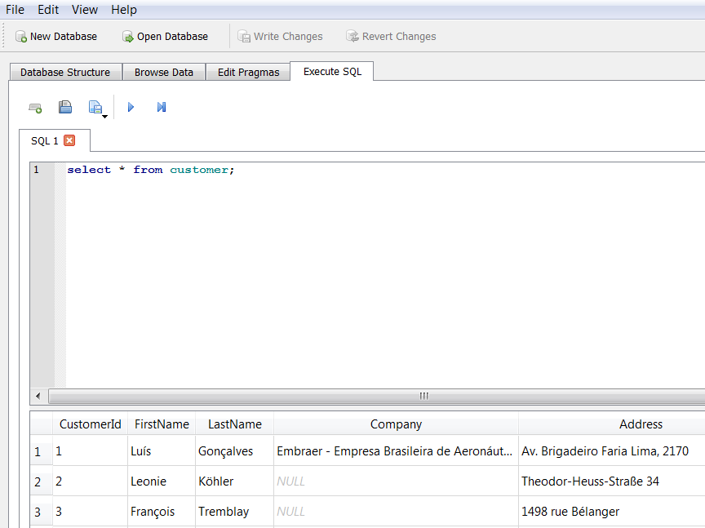
SQLite/DB4S basics
Open database file
Write and execute SQL statements
File > Import > Table from CSV file…
Browse tables, columns, and records
Execute SQL statement (also F5 or SHIFT + F5)
SQL statement
Result set
Notes:
https://sqlite.org/lang_corefunc.html

Slide 27
Comments!
Adding comments is a best practice when writing code, in any programming language
These statements are not evaluated by the SQL engine but help the reader understand the intent and the approach behind an individual line of code or the script as a whole
In SQL, single-line comments are generally preceded by a double dash (“--”), while block comments across multiple lines are marked by “/* … */”

Slide 28
Chinook sample database
Chinook is a digital media store with several employees
Customers can buy individual tracks from a variety of musical artists
The database contains master and transactional data for the business
Download the database and open the Chinook_Sqlite.sqlite file in DB4S

Slide 29
SELECT statement
A SELECT statement is used to fetch records from a database table in the form of a table called a result set
One or more columns may be specified, or the asterisk (*) can be used to return all records from the table
Use the LIMIT keyword to return only the first n rows from the result set
The result set is not stored in the database without the use of additional functions
SELECT column1, column2, column3 FROM table_name
SELECT * FROM table_name
SELECT column1, column2, column3 FROM table_name LIMIT 5

Slide 30
CREATE TABLE statement
A CREATE TABLE statement is used to add the result set from a query to the database as a new table
Complicated queries can be broken down by creating intermediate tables
The ability to create a table depends on the level of access granted to a user, so it may not be possible in some situations
CREATE TABLE new_table AS
SELECT column1, column2, column3 FROM table_name

Slide 31
ORDER BY
The ORDER BY keyword can be added to a SELECT statement to sort the records
The typical default order is ascending (ASC), but you can also specify descending (DESC)
SELECT column1, column2, column3 FROM table_name
ORDER BY column2, column1, column3 DESC

Slide 32
COUNT
The COUNT function returns the number of records in the result set
The input parameter can be * or 1
SELECT COUNT(*) FROM table_name
SELECT COUNT(1) FROM table_name

Slide 33
Exercise #1
Answer the following questions:
How many columns does the customer table have?
If you select only the first 5 rows, what is the country in the last row?
If you sort the table on last name, what is the last name in the third row?
How many rows are in the invoice table?

Slide 34
WHERE clause
The WHERE clause can be added to a SELECT statement to filter records that meet certain conditions, i.e. return a subset of the table
We use expressions to define these conditions
Most conditional operators are self-explanatory (=, <, >, etc.)
A common operator for “not equals” is <> or !=
SELECT column1, column2, column3 FROM table_name WHERE column1 = ‘ABC’
SELECT column1, column2, column3 FROM table_name WHERE column2 > 100
SELECT column1, column2, column3 FROM table_name WHERE column3 <> 0

Slide 35
Comparative operators
Operator | Operator Description | Example (a = 10, b = 20)
= | Checks if the values of two operands are equal or not, if yes then condition becomes true | (a = b) is not true
!= | Checks if the values of two operands are equal or not, if values are not equal then condition becomes true | (a != b) is true
<> | Checks if the values of two operands are equal or not, if values are not equal then condition becomes true | (a <> b) is true
> | Checks if the value of left operand is greater than the value of right operand, if yes then condition becomes true | (a > b) is not true
< | Checks if the value of left operand is less than the value of right operand, if yes then condition becomes true | (a < b) is true

Slide 36
AND/OR
An AND/OR operator can be added to a WHERE clause to filter records on based on multiple conditions
The AND operator returns all records where both conditions are true
The OR operator returns all records if either the first condition or the second condition are true
SELECT column1, column2, column3 FROM table_name
WHERE a_condition AND another_condition
SELECT column1, column2, column3 FROM table_name
WHERE a_condition OR another_condition

Slide 37
IN
The IN operator can be used to specify multiple values in a WHERE clause
This is equivalent to a series of OR clauses
SELECT column1, column2, column3 FROM table_name
WHERE column1 IN (value1, value2, …, valueN)
SELECT column1, column2, column3 FROM table_name
WHERE column1 = value1 OR column1 = value OR … OR column1 = valueN

Slide 38
BETWEEN
The BETWEEN operator can be used in a WHERE clause to select values within a range
SELECT column1, column2, column3 FROM table_name
WHERE column2 BETWEEN value1 AND value2

Slide 39
LIKE
The LIKE operator can be used in a WHERE clause to search for a specified pattern in a column
LIKE supports the several wildcards
SELECT column1, column2, column3 FROM table_name
WHERE column2 LIKE ‘%value1%’
Wildcard | Description
% | A substitute for zero or more characters
_ (underscore) | A substitute for a single character
[charlist] | Sets and ranges of characters to match
[^charlist] | Matches only a character NOT specified within the brackets

Slide 40
NULL and NOT
NULL means that a value has not been entered for a particular column in a row, i.e. the value is missing
NULL is not numeric or any other value so it can’t equal itself or anything else
NOT creates the negation of an expression
To test for a NULL value you will want to use the expressions IS NULL or IS NOT NULL
SELECT column1, column2 FROM table_name
WHERE column2 IS NULL
SELECT column1, column2 FROM table_name
WHERE column2 IS NOT NULL

Slide 41
Exercise #2
Answer the following questions:
How many invoices have totals greater than $20?
How many invoices have totals greater than $10 and less than $20?
How many invoices are from customers in Brazil, Argentina, or Chile?
How many invoices have a billing country that starts with “C”?
How many customers list their company?

Slide 42
Expressions
An expression is a combination of one or more values, operators, and SQL functions that evaluates to a value
Any time the data must be displayed, filtered, or ordered in a way that is different from how it is stored, you can use expressions and functions to manipulate it
We can use expressions to create calculated or derived fields, as in the example below:
end_bal – beg_bal is the expression
Minus (-) is an operator
end_bal and beg_bal are columns in the existing table
AS “difference” provides a name for a new column in the result set
SELECT column1, end_bal, end_bal – beg_bal AS “difference”
FROM table_name

Slide 43
Arithmetic operators
Operator | Description
+ | Adds values on either side of the operator
- | Subtracts right hand operand from left hand operand
* | Multiplies values on either side of the operator
/ | Divides left hand operand by right hand operand
% | Divides left hand operand by right hand operand and returns remainder (“modulus”)

Slide 44
String functions
The RTRIM and LTRIM functions remove spaces from the right side or left side of a string
RTRIM(<string>)
LTRIM(<string>)
Use SUBSTR to return a portion of a string starting at a given position and for a specified number of characters
SUBSTR(<string>,<start location>,<length>)
Use LENGTH to return the number of characters in a string (other SQL implementations may use LEN)
LENGTH(<string>)

Slide 45
String functions (continued)
Use UPPER and LOWER to change a string to either uppercase or lowercase
You may need to display all uppercase data in a report, for example
UPPER(<string>)
LOWER(<string>)
Use REPLACE to substitute one string value for another
Use REPLACE to clean up data; for example, you may need to replace slashes (/) in a phone number column with hyphens (-) for a report
REPLACE(<string value>,<string to replace>,<replacement>)
SELECT column1, REPLACE (column1, ‘/’, ‘-’) AS new_col
FROM table_name

Slide 46
Numeric functions
Use ROUND to specify a number of significant digits:
SELECT column1, ROUND (column1, 2) AS new_col
FROM table_name
Use RANDOM in combination with the absolute value function ABS and modulus operator % to generate a random number on a specific range:
SELECT *, ABS(RANDOM() % 100) AS new_col
FROM table_name

Slide 47
Date functions
Different SQL implementations have varying functions and operators for dates and times
In SQLite, date objects are created by DATE and related functions, and arithmetic operators are used to do calculations involving dates
DATE(‘now’) returns the current date and time of the server
JULIANDAY interprets dates in the standard YYYY-MM-DD format
STRFTIME provides flexible options for managing dates and times using substitutions shown at right
Sub | Description
%d | day of month: 00
%f | fractional seconds: SS.SSS
%H | hour: 00-24
%j | day of year: 001-366
%J | Julian day number
%m | month: 01-12
%M | minute: 00-59
%s | seconds since 1970-01-01
%S | seconds: 00-59
%w | day of week 0-6 with Sunday = 0
%W | week of year: 00-53
%Y | year: 0000-9999

Slide 48
Example – Date functions
SELECT JULIANDAY('now') - JULIANDAY('1776-07-04');
SELECT column1, STRFTIME(‘%Y-%m-%d’, column1) AS new_col
FROM table_name
SELECT column1, STRFTIME(‘%w’, column1) AS new_col
FROM table_name
SELECT column1, STRFTIME(‘%W’, column1) AS new_col
FROM table_name

Slide 49
CAST
The CAST function is used for explicitly changing the data type of a column, often from text to numeric and vice versa
Available data types include:
INT - Integer
CHAR - Text
TEXT - Text
REAL - Numeric
FLOAT - Numeric
SELECT column1, CAST(column1 AS INT) AS int_col FROM table_name
SELECT column2, CAST(column2 AS CHAR) AS char_col FROM table_name

Slide 50
Exercise #3
Answer the following questions:
How many employees does Chinook have?
Create a new column that shows their phone numbers without the area code.
How long is the longest last name?
How many employees were born on a Sunday?
How old was the oldest employee when they were hired?

Slide 51
DISTINCT
The DISTINCT function returns the unique values in a column or unique records across multiple columns
The combination of COUNT and DISTINCT returns the number of unique values
SELECT DISTINCT column1 FROM table_name
SELECT COUNT(DISTINCT column1) FROM table_name

Slide 52
Aggregate functions
The following functions, including COUNT, calculate totals or statistics by column
These statistics can apply to all rows or groupings of rows using GROUP BY
Other SQL implementations may include additional statistics (standard deviation, variance, median, etc.)
Function | Description
COUNT() | Counts the total number of records
SUM() | Sum of numeric values
AVG() | Finds the average
MIN() | Returns the smallest number
MAX() | Returns the largest number

Slide 53
GROUP BY clause
The SQL GROUP BY clause is used in collaboration with the SELECT statement to aggregate by groups (similar to Excel’s pivot table).
The GROUP BY clause follows the WHERE clause and precedes the ORDER BY clause (if present)
This clause regularly makes use of SQL’s aggregate functions; when used with GROUP BY, each aggregate function produces a single value for each group
SELECT column1, column2, count(1) as ct, sum(column1) as sum1
FROM table_name
WHERE a_condition
GROUP BY column1, column2
ORDER BY column2, column1

Slide 54
Example – GROUP BY with aggregate function
OrderID | CustID | Date | Amount
1 | 2 | 2/15/2015 | 100.22
2 | 1 | 3/18/2015 | 99.95
3 | 3 | 5/11/2015 | 122.95
4 | 3 | 7/28/2015 | 100
5 | 4 | 8/18/2015 | 555.55
6 | 7 | 7/4/2015 | 1000
7 | 3 | 7/15/2015 | 458
8 | 1 | 10/18/2015 | 323
9 | 2 | 5/11/2015 | 355
10 | 3 | 3/28/2015 | 77
11 | 7 | 8/18/2015 | 113
12 | 2 | 4/4/2015 | 130
13 | 4 | 8/18/2015 | 448
14 | 3 | 1/4/2015 | 449
SELECT
CustID, SUM(Amount) AS TotalAmount
FROM Orders
GROUP BY CustID
ORDER BY TotalAmount DESC
Result set:
CustID | TotalAmount
3 | 1206.95
7 | 1113
4 | 1003.55
2 | 585.22
1 | 422.95

Slide 55
HAVING clause
The HAVING clause can be added to GROUP BY to filter records that meet certain conditions, i.e. return a subset of the groupings
Operators are the same as the WHERE clause
SELECT column1, column2, count(1) as counts FROM table_name
GROUP BY column1, column2 HAVING counts > 5
SELECT column1, count(1) as counts, sum(column2) as sum2
FROM table_name GROUP BY column1
HAVING counts > 1 and sum2 > 10000

Slide 56
CASE
Use the CASE function to evaluate a list of expressions and return the first one that evaluates to true
CASE can be used inside aggregations to generate a statistic (e.g. sum) only for certain records
SELECT column1, column2,
CASE <test expression>
WHEN <comparison expression1> THEN <return value1>
WHEN <comparison expression1> THEN <return value1>
ELSE <default value>
END AS new_field_name
FROM table_name
SELECT column1, SUM(
CASE <test expression>
WHEN <comparison expression1> THEN 1 ELSE 0
END AS new_field_name
) FROM table_name GROUP BY column1

Slide 57
Exercise #4
Answer the following questions:
Return a list of countries by the total value of invoices in descending order.
How many invoice line items are there?
How many distinct prices are there?
How many downloads of each price have happened?
Which tracks have been downloaded the most times?
What is the range of invoice dates covered by the database?

Slide 58
JOIN clause
A JOIN combines fields from two tables using a key column shared by the tables
SELECT table_a.column1, table_a.column2, table_b.column3
FROM table_a JOIN table_b ON table_a.column1 = table_b.column1
key

Slide 59
Aliases
SQL aliases are used to temporarily refer to a table or a column by a different name
Aliases are commonly used in join clauses to save space and keystrokes
SELECT
Employee.BusinessEntityID,
FirstName,
LastName,
JobTitle,
BirthDate
FROM HumanResources.Employee
INNER JOIN Person.Person ON
Employee.BusinessEntityID = Person.BusinessEntityID
SELECT
e.BusinessEntityID,
FirstName,
LastName,
JobTitle,
BirthDate
FROM HumanResources.Employee AS e
INNER JOIN Person.Person AS p ON
e.BusinessEntityID = p.BusinessEntityID
aliases

Slide 60
JOIN types
 | INNER JOIN Selects rows from both tables as long as there is a match between the key columns in both tables
 | LEFT JOIN Returns all rows from the left table (1), with the matching rows in the right table (2); the result is NULL in the right side when there is no match
 | RIGHT JOIN Returns all rows from the right table (2), with the matching rows in the left table (1); the result is NULL in the left side when there is no match
 | FULL OUTER JOIN Returns all rows from the left table (1) and from the right table (2); the result is NULL in the left or right side when there is no match
1
2
1
2
1
2
1
2

Slide 61
INNER join
customers
orders
CustID | FirstName | LastName | Email
1 | John | Smith | John.Smith@yahoo.com
2 | Steven | Goldfish | goldfish@fishhere.net
3 | Paula | Brown | pb@herowndomain.org
4 | James | Smith | jim@supergig.co.uk
5 | Mary | Stevens | mstevens@gmail.com
OrderID | CustID | Date | Amount
1 | 2 | 2/15/2015 | 100.22
2 | 1 | 3/18/2015 | 99.95
3 | 3 | 5/11/2015 | 122.95
4 | 3 | 7/28/2015 | 100.00
5 | 4 | 8/18/2015 | 555.55
6 | 7 | 7/4/2015 | 1000.00
SELECT
customers.CustID,
customers.LastName,
customers.FirstName,
orders.Date,
orders.Amount
FROM Customers
INNER JOIN Orders ON customers.CustID = orders.CustID
Query Result:
CustID | FirstName | LastName | Date | Amount
1 | John | Smith | 3/18/2015 | 99.95
2 | Steven | Goldfish | 3/18/2015 | 99.95
3 | Paula | Brown | 5/11/2015 | 122.95
3 | Paula | Brown | 7/28/2015 | 100
4 | James | Smith | 8/18/2015 | 555.55

Slide 62
LEFT join
customers
orders
CustID | FirstName | LastName | Email
1 | John | Smith | John.Smith@yahoo.com
2 | Steven | Goldfish | goldfish@fishhere.net
3 | Paula | Brown | pb@herowndomain.org
4 | James | Smith | jim@supergig.co.uk
5 | Mary | Stevens | mstevens@gmail.com
OrderID | CustID | Date | Amount
1 | 2 | 2/15/2015 | 100.22
2 | 1 | 3/18/2015 | 99.95
3 | 3 | 5/11/2015 | 122.95
4 | 3 | 7/28/2015 | 100.00
5 | 4 | 8/18/2015 | 555.55
6 | 7 | 7/4/2015 | 1000.00
SELECT
customers.CustID,
customers.LastName,
customers.FirstName,
orders.Date,
orders.Amount
FROM Customers
LEFT JOIN Orders ON customers.CustID = orders.CustID
Query Result:
CustID | FirstName | LastName | Date | Amount
1 | John | Smith | 3/18/2015 | 99.95
2 | Steven | Goldfish | 3/18/2015 | 99.95
3 | Paula | Brown | 5/11/2015 | 122.95
3 | Paula | Brown | 7/28/2015 | 100
4 | James | Smith | 8/18/2015 | 555.55
5 | Mary | Stevens | NULL | NULL

Slide 63
RIGHT join
customers
orders
CustID | FirstName | LastName | Email
1 | John | Smith | John.Smith@yahoo.com
2 | Steven | Goldfish | goldfish@fishhere.net
3 | Paula | Brown | pb@herowndomain.org
4 | James | Smith | jim@supergig.co.uk
5 | Mary | Stevens | mstevens@gmail.com
OrderID | CustID | Date | Amount
1 | 2 | 2/15/2015 | 100.22
2 | 1 | 3/18/2015 | 99.95
3 | 3 | 5/11/2015 | 122.95
4 | 3 | 7/28/2015 | 100.00
5 | 4 | 8/18/2015 | 555.55
6 | 7 | 7/4/2015 | 1000.00
SELECT
orders.OrderID,
customers.LastName,
customers.FirstName,
orders.Date,
orders.Amount
FROM Customers
RIGHT JOIN Orders ON customers.CustID = orders.CustID
Query Result:
OrderID | FirstName | LastName | Date | Amount
1 | Steven | Goldfish | 2/15/2015 | 100.22
2 | John | Smith | 3/18/2015 | 99.95
3 | Paula | Brown | 5/11/2015 | 122.95
4 | Paula | Brown | 7/28/2015 | 100
5 | James | Smith | 8/18/2015 | 555.55
6 | NULL | NULL | 7/4/2015 | 1000.00

Slide 64
FULL OUTER join
customers
orders
CustID | FirstName | LastName | Email
1 | John | Smith | John.Smith@yahoo.com
2 | Steven | Goldfish | goldfish@fishhere.net
3 | Paula | Brown | pb@herowndomain.org
4 | James | Smith | jim@supergig.co.uk
5 | Mary | Stevens | mstevens@gmail.com
OrderID | CustID | Date | Amount
1 | 2 | 2/15/2015 | 100.22
2 | 1 | 3/18/2015 | 99.95
3 | 3 | 5/11/2015 | 122.95
4 | 3 | 7/28/2015 | 100.00
5 | 4 | 8/18/2015 | 555.55
6 | 7 | 7/4/2015 | 1000.00
SELECT
customers.CustID,
orders.OrderID,
customers.LastName,
customers.FirstName,
orders.Date,
orders.Amount
FROM Customers
FULL OUTER JOIN Orders ON customers.CustID = orders.CustID
Query Result:
CustID | OrderID | FirstName | LastName | Date | Amount
1 | 2 | John | Smith | 3/18/2015 | 99.95
2 | 1 | Steven | Goldfish | 2/15/2015 | 100.22
3 | 3 | Paula | Brown | 5/11/2015 | 122.95
3 | 4 | Paula | Brown | 7/28/2015 | 100.00
4 | 5 | James | Smith | 8/18/2015 | 555.55
5 | NULL | Mary | Stevens | NULL | NULL
NULL | 6 | NULL | NULL | 7/4/2015 | 1000.00

Slide 65
Example – Join with GROUP BY
orders
SELECT
o.CustID,
c.FirstName,
c.LastName,
SUM(o.Amount) AS “TotalAmount”
FROM orders AS o
INNER JOIN customers AS c ON o.clientID = c.clientID
GROUP BY o.CustID, c.FirstName, c.LastName
ORDER BY TotalAmount DESC
OrderID | CustID | Date | Amount
1 | 2 | 2/15/2015 | 100.22
2 | 1 | 3/18/2015 | 99.95
3 | 3 | 5/11/2015 | 122.95
4 | 3 | 7/28/2015 | 100
5 | 4 | 8/18/2015 | 555.55
6 | 7 | 7/4/2015 | 1000
7 | 3 | 7/15/2015 | 458
8 | 1 | 10/18/2015 | 323
9 | 2 | 5/11/2015 | 355
10 | 3 | 3/28/2015 | 77
11 | 7 | 8/18/2015 | 113
12 | 2 | 4/4/2015 | 130
13 | 4 | 8/18/2015 | 448
14 | 3 | 1/4/2015 | 449
Query Result:
customers
CustID | FirstName | LastName | TotalAmount
3 | Paula | Brown | 1206.95
7 | NULL | NULL | 1113
4 | James | Smith | 1003.55
2 | Steven | Goldfish | 585.22
1 | John | Smith | 422.95
CustID | FirstName | LastName | Email
1 | John | Smith | John.Smith@yahoo.com
2 | Steven | Goldfish | goldfish@fishhere.net
3 | Paula | Brown | pb@herowndomain.org
4 | James | Smith | jim@supergig.co.uk
5 | Mary | Stevens | mstevens@gmail.com

Slide 66
Combining queries
SELECT statements can be combined to avoid hard-coding values or creating intermediate tables
In a simple case, an additional SELECT statement returns a value for use in a condition:
SELECT * FROM table_name WHERE column1 >
(SELECT AVG(column1) FROM table_name);
More complex queries with multiple layers of nesting may require the use of aliases
SELECT COUNT(*) FROM (SELECT * FROM table_name WHERE column1 >
(SELECT AVG(column1) FROM table_name)) temp;

Slide 67
Exercise #5
Answer the following questions:
Return the top five most downloaded tracks with the full name of the track and number of downloads.
How many distinct albums have actually been downloaded?
What is the most popular genre?

Slide 68
Assignment

Slide 69
Assignment #1 – Excel and SQL
You have been hired by the Office of the Mayor in New York City to review data from city operations for opportunities to improve services. In particular, the Mayor has heard complaints from some citizens that film shoots in the city are causing too much disruption. The city has provided historical data on film permits and noise complaints.
Your assignment is to perform initial profiling and descriptive analysis of the data to understand more about the situation. Submissions are due by XXXXXXXXXX.
Import ‘NYC_Film_Permits.csv’ into Excel. Import the same file and ‘NYC_Noise_Complaints.tsv’ into SQLite.
Answer questions 1-30 in ‘Assignment_1_Answers.xlsx’ and add a brief description of how you determined the answer. This file should only include your answers, not the data. Add your student ID # to the end of the file name.
Upload the Excel workbook, including the data, that you used to answer questions 1-20. This file should be called ‘Assignment_1_Excel_<STUDENTID>.xlsx’.
Upload the SQL script that you used to answer questions 21-30. Your script should follow the template ‘Assignment_1_SQL.sql’. Add your STUDENTID to the end of the file name.

Slide 70
Assignment #1 – Inputs and Outputs
File Name
Assignment_1_Answers.slsx
Assignment_1_SQL.sql
NYC_Film_Permits.dsv
NYC_Noise_Complaints.tsv
File Name
Assignment_1_Answers_ss12345.xlsx
Assignment_1_Excel_ss12345.xlsx
Assignment_1_SQL_ss12345.sql

Slide 71
Assignment #1 – Importing data to SQLite
Follow these steps to import the delimited text files into SQLite:
Download and unzip the files.
Click ‘New Database’
Specify a name and location for the.db file and click ‘Save’
Click ‘Cancel’ on the dialog box that appears
File > Import > Table from CSV…
For the.tsv file, select ‘All Files (*)’ from the drop-down (Windows) or Options (Mac)
Select the file and click ‘Open’
Update ‘Field Separator’ to comma (.csv) or tab (.tsv)
Check box for ‘Column names in first line’
Wait for the data to be inserted into a database table
Check the results on the ‘Database Structure’ tab and run a simple query against the table.

Slide 72
Summary

Slide 73
Acquire data
Task | Description | SQL
Data access | Connect to a data source
Importing data | Read the data into an analytical environment | New Database > File > Import > Table from CSV File
Data profiling | Review data dimensions and summary statistics | COUNT DISTINCT MIN, MAX, SUM, AVG, etc. ORDER BY
Data quality assessment | Identify aspects of the data that pose challenges for subsequent analysis | IS NULL IS NOT NULL
Data simulation | Generate data based on analytical requirements | RANDOM

Slide 74
Transform data
Task | Description | SQL
Cleaning data | Address data quality issues to facilitate analysis | LTRIM, RTRIM, UPPER, LOWER, etc. ROUND
Changing data types | Convert a value to the appropriate format for analysis | CAST AS
Filtering data | Create subsets of records and features based on specified conditions | WHERE IN, BETWEEN, LIKE HAVING
Deriving data | Create new features from original features | AS REPLACE, SUBSTR, etc. JULIANDAY, etc. CASE, IF
Scaling data | Put features with different ranges of values on the same scale while preserving relative values | MIN, MAX, SUM, AVG, etc.
Notes:
Data wrangling, munging, preparation…

Slide 75
Transform data (continued)
Task | Description | SQL
Sampling data | Create subsets of records based on a probability distribution | RANDOM
Aggregating data | Return a statistic or value for one feature according to different values of another feature | GROUP BY MIN, MAX, SUM, AVG, etc.
Reshaping data | Change whether values are represented in different records or different features
Concatenating data | Combine data sets through juxtaposition | UNION UNION ALL
Merging data | Combine data sets by matching records on a common identifier | INNER JOIN LEFT JOIN
Notes:
Data wrangling, munging, preparation…

Slide 76
Analyze data
Task | Description | SQL
Summary analysis | Calculate representative statistics for features of interest | MIN, MAX, SUM, AVG, etc.
Perform statistical tests | Estimate the probability that the data supports a specific claim
Clustering | Identify similar groups of records
Predictive modeling | Use one set of features to predict the value of another feature
Network analysis | Examine relationships between entities

Slide 77
Present findings
Task | Description | SQL
Data visualization | Display data using lines, shapes, colors, and other abstract representations
Dashboarding | Create a collection of dynamic visualizations
Exporting data | Produce output from an analytical environment for future use | Copy/paste File > Export > Table(s) as CSV file…
Make recommendations | Use results of data analysis to guide decision-making

Slide 78
Appendix

Slide 79
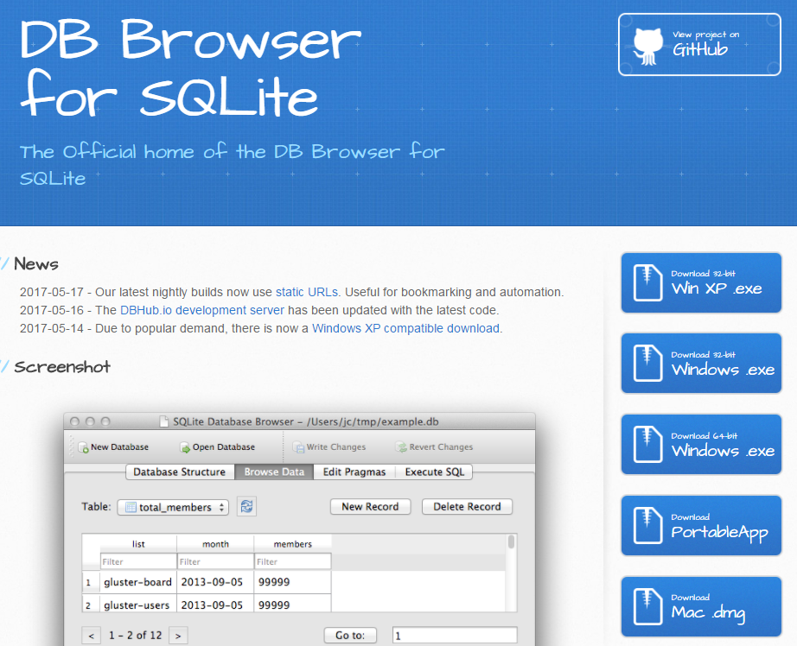
Step #1 – Download and install DB4S
http://sqlitebrowser.org/

Slide 80
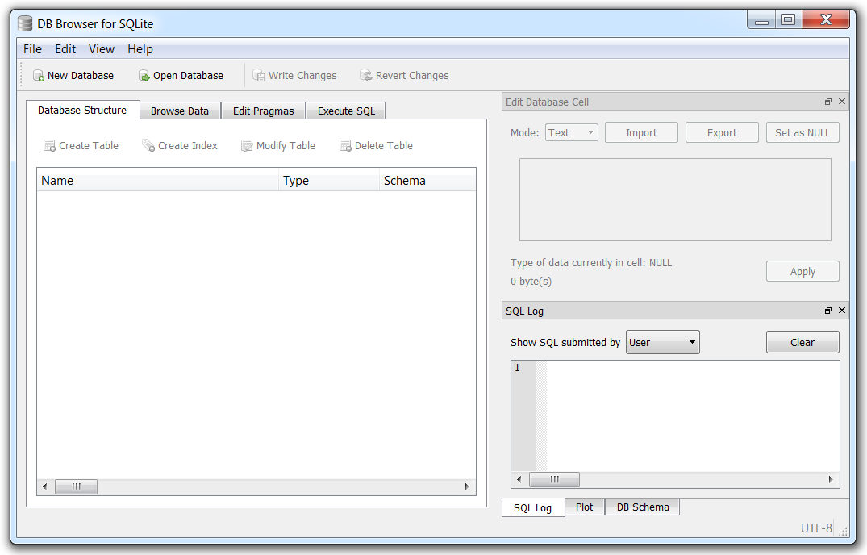
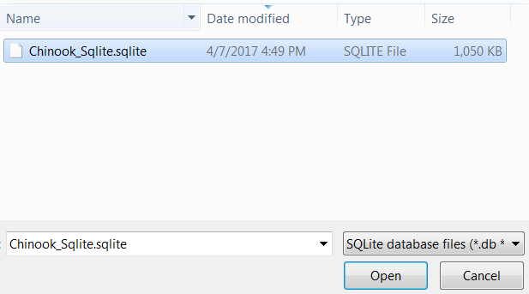
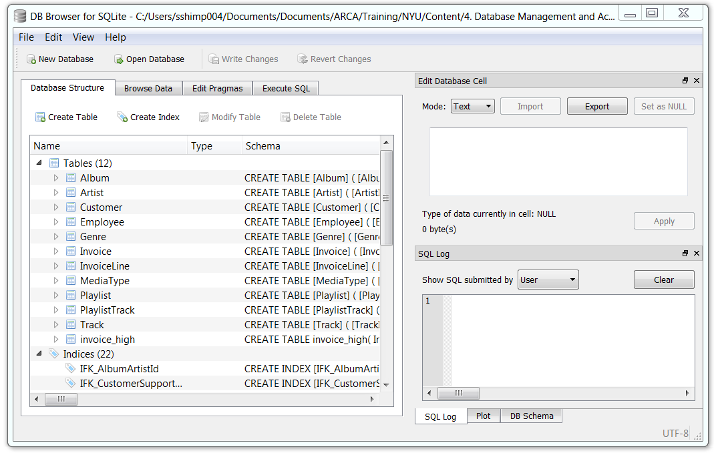
Step #2 – Start DB4S and open the sample.sqlite file

Slide 81
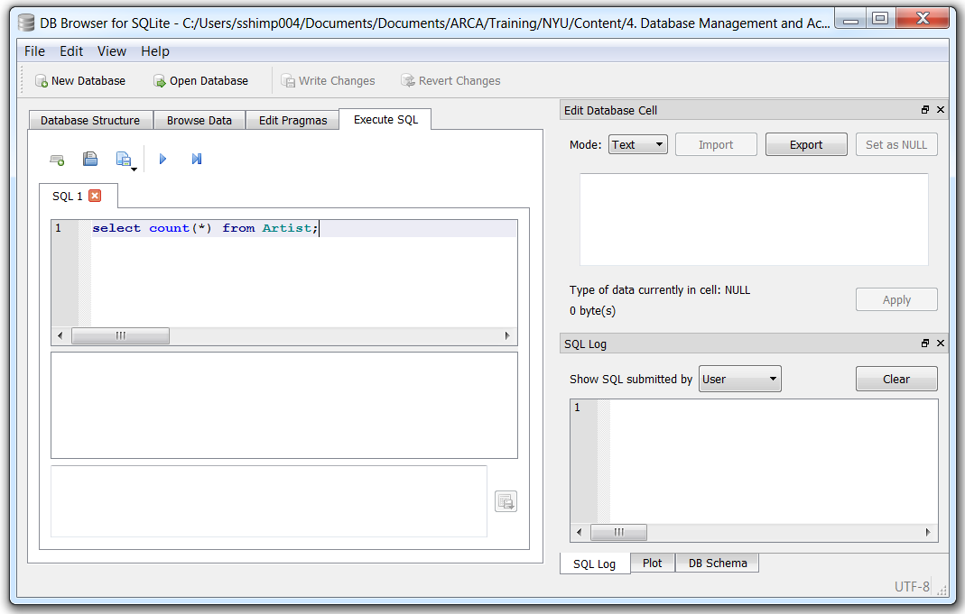
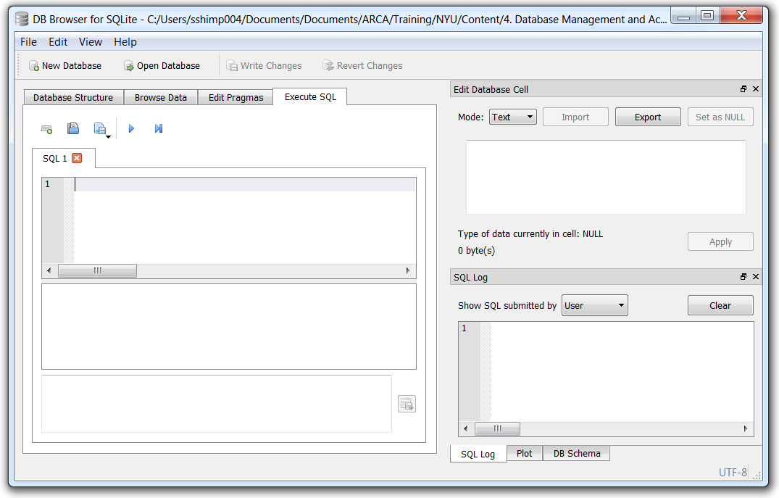
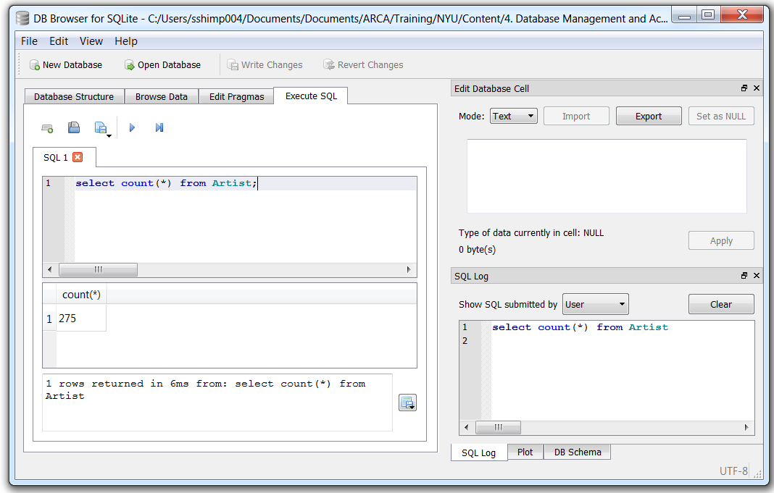
Step #3 – Execute a simple query
Go to ‘Execute SQL’ tab
Enter the following SQL query: select count(*) from Artist;
Click the forward button to execute the current line and check for results
Always add a semi-colon (;) at the end of a query
2
1
3

Slide 82
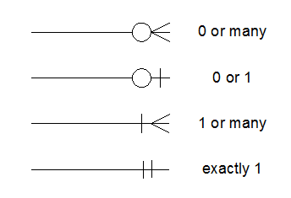
Exercise – Entity relationship diagram
Work in groups to create an entity relationship diagram for an Accounts Payable module with at least 5 tables
Table
Relationships
Primary key
Column 1
Column 2
Foreign key

Slide 83
© 2018 PwC. All rights reserved. PwC refers to the US member firm or one of its subsidiaries or affiliates, and may sometimes refer to the PwC network. Each member firm is a separate legal entity. Please see www.pwc.com/structure for further details.

