Slide 1
Bibitor LLC *
Inventory Analysis Case Study
Phase 1
*Note1: Bibitor, LLC is a fictitious company based on data created by the HUB of Analytics Education @ www.hubae.org.

Slide 2
Introduction and Case Overview

Slide 3
Objectives
This case study is designed to enhance your understanding and knowledge of data analytics, including leveraging analytics to make business decisions.
By completing this case, you will obtain the following:
An understanding of what data analytics and visualization are
The ability to utilize analytic tools
Comfort in leveraging data in making decisions
Skills to select data components for analysis and illustrate results to highlight data tracking and identify conditions for exception analysis or business advisory strategy

Slide 4
Case Format
You should plan to work in teams of 2 to 3 students to complete the case. This will give you the opportunity to share the learning, knowledge, and experience.
This case will be delivered in three phases. Each phase includes an instructional component to learn how to manage the data within the tool and case study exercises utilizing the skills.
Phase 1: Introduction to Data Preparation
Load data exported from company into SQLite to put it into a format for analysis and create tables which can be used by other analysis tools.
Phase 2: Introduction to Data Discovery and Visualization
Using tables created in Phase 1, load data into Tableau to perform analysis then create and interpret visualizations.
Phase 3: Introduction to Statistical Analysis
Analyze one set of independent/dependent variables from each of the two case studies and create a tableau worksheet that uses linear regression to provide some insight into the data.

Slide 5
Case Materials
All the materials required to complete the case can be found at ((LOCATION)).
Notes:
Instructor Note: Please update this slide with the location where you have uploaded the case materials to make them available to the students.

Slide 6
Case Background
Bibitor, LLC* is a liquor store chain in the fictional state of Lincoln. It is a major retailer with approximately 80 locations and total sales in excess of $450 million.
Bibitor has asked the team to complete due diligence on their wine and spirits business looking at data for their beginning and ending inventory, purchases and sales for a 12 month period.
*Bibitor, LLC is a fictitious company based on data created by the HUB of Analytics Education @ www.hubae.org. The HUB of Analytics Education materials are owned by Northeastern University. PricewaterhouseCoopers LLP is not responsible for any errors or omissions in, or for the results obtained from the use of, the HUB of Analytics Education. The HUB of Analytics Education materials are provided "as is", with no guarantee of completeness, accuracy, timeliness or of the results obtained from the use of this information, and without warranty of any kind. In no event will PricewaterhouseCoopers LLP, or its partners, principals, employees, or agents, be liable to you or anyone else for any decision made or action taken in reliance on the information in the HUB of Analytics Education materials or for any consequential, special or similar damages, even if advised of the possibility of such damages.

Slide 7
Getting Started – Phase 1 Pre-work
Download/Install SQLite application (SQLite DB Browser is preferred; http://sqlitebrowser.org/ )
Download Datasets (listed in image below) onto local machine
Note: minimum disk space required = 3GB
Read/Review general background on Relational Databases: https://www.webucator.com/tutorial/learn-sql/relational-database-basics/relational-databases-reading.cfm#tutorial
Complete these Supplemental SQL exercises: https://sqlzoo.net/wiki/SELECT_names
Notes:
Instructor Note: Depending on timing and availability, you may want to have the students complete this pre-work in the classroom with a TA or other support person available who is proficient with SQLite.

Slide 8
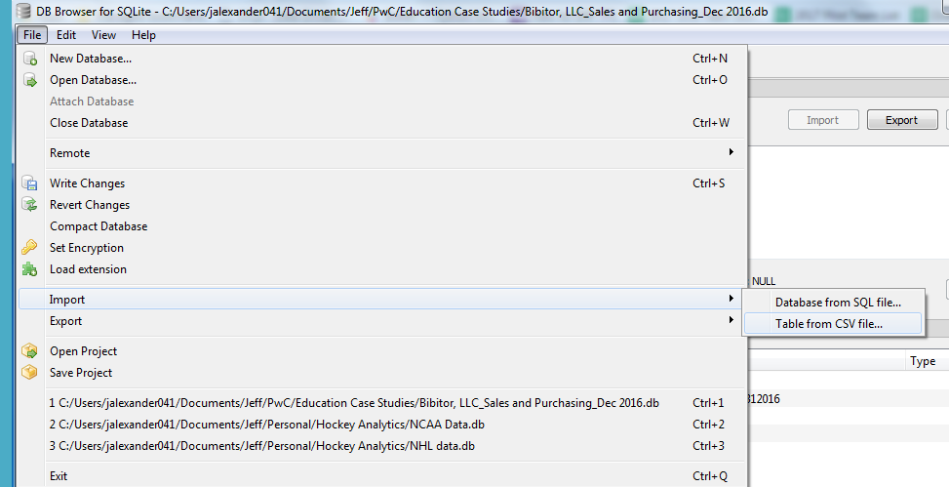
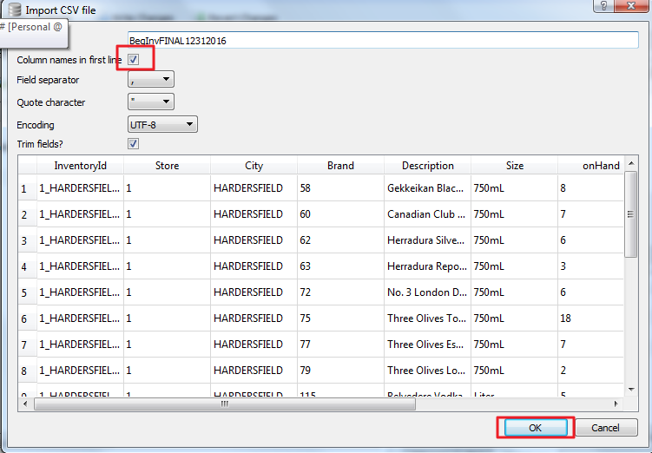
Getting Started – Phase 1 Pre-work
Create a New Database and Import data into SQLite
Open SQLite DB Browser and select ‘New Database’; this .db file can be arbitrarily named by the user.
Note: You will need to click ‘Save’ before closing as the application will not ask you to ‘Save’ your file; otherwise, you will lose all work performed.
The datasets identified in (Prerequisite #2) are in .csv file format, which are readable by the standard SQLite import function. Each can be imported individually by going to File→Import→Table from CSV file-→and selecting the respective .csv file. Be sure to check the ‘Column Names in first line’ box when importing.

Slide 9
Getting Started – Phase 1 Pre-work
Once all tables are imported, rename each table (by right-clicking on the table, and selecting ‘Modify Table’) for purposes of query simplicity:
Note 1: you can also rename the files in Windows Explorer prior to the import.
Note 2: if you incorrectly import a table without column headers, you can drop that table using (DELETE TABLE [Table Name]) and re-importing.
‘SalesFINAL12312016’ to ‘SalesDec’
‘Purchases12312016’ to ‘PurchasesDec’
‘InvoicePurchases12312016’ to ‘VendorInvoicesDec’
‘EndInvFINAL12312016’ to ‘EndInvDec’
‘BegInvFINAL12312016’ to ‘BegInvDec’
‘2017PurchasePricesDec’ to ‘PricingPurchasesDec’

Slide 10
Phase 1: Introduction to Data Collection and Preparation (in SQLite)

Slide 11
Accessing Data and Preparing It for Analysis
To effectively utilize data after it has been exported from the company’s system, the data must be appropriately formatted and tested for completion.
The steps in this phase outline the process of taking the original source files downloaded from the company and importing them into SQLite to perform analysis and create tables which can be used by other data analysis tools.

Slide 12
Review of Pre-Work
Notes:
Instructor Note: If the students completed the pre-work outside of class, you may want to use this time to review their results to ensure they have all the data downloaded correctly.

Slide 13
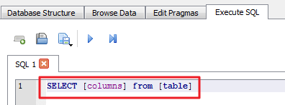
Basic ‘Select” Syntax and Features
The ‘Select’ statement will return a result set of records for specified columns, from a specific table, for those records meeting specified conditions. Basic ‘Select’ statement syntax is as follows:
Note: It may be helpful to google "SQL Quick Reference From W3Schools" for a handy listing of statements/clauses in this SQLite reference guide.

Slide 14
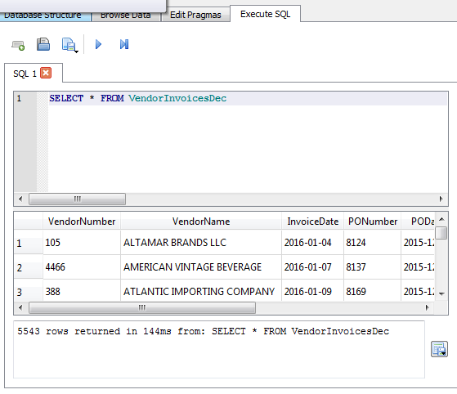
Practice Ex. 1: Select ALL records/columns from the ‘VendorInvoicesDec’ table
(Hint: use an asterisk as a key word to indicate that all columns should be returned in the results).

Slide 15
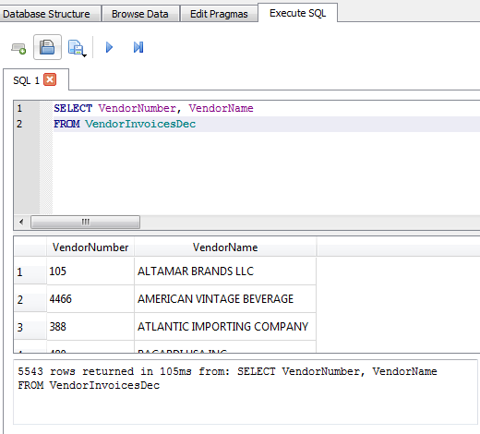
Practice Ex. 2: Select Columns ‘VendorNumber’ and ‘VendorName’ (all records) from the ‘VendorInvoicesDec’ table.

Slide 16
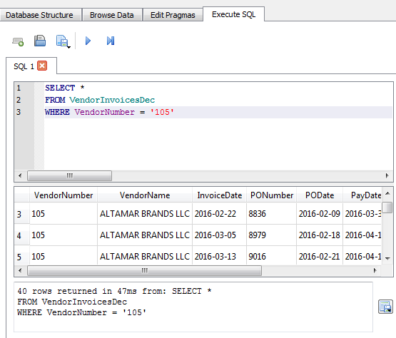
Basic ‘Select” Syntax and Features
‘Where’ clauses all for conditions to be applied to the select statement. For example, if we only want VendorNumber ‘105’, we execute the following:

Slide 17
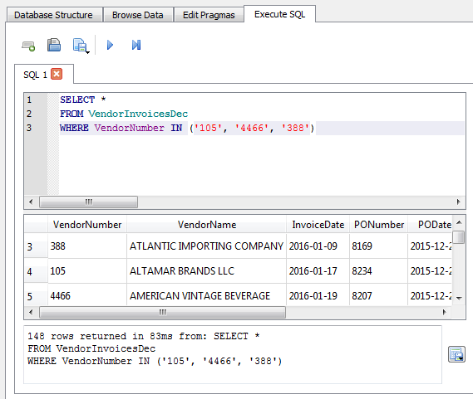
Basic ‘Select” Syntax and Features
If we want to execute the same condition, but for multiple values for ‘VendorNumber’, we use an ‘IN’ clause within that same WHERE condition:

Slide 18
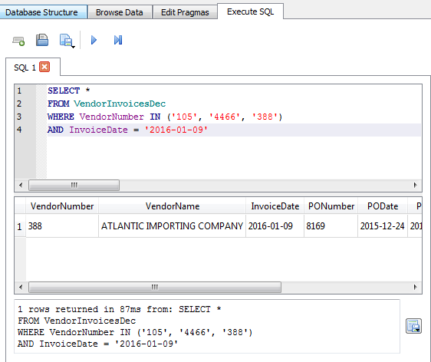
Basic ‘Select” Syntax and Features
If we want to set multiple conditions, we can use an ‘AND’ operator after the initial WHERE clause:

Slide 19
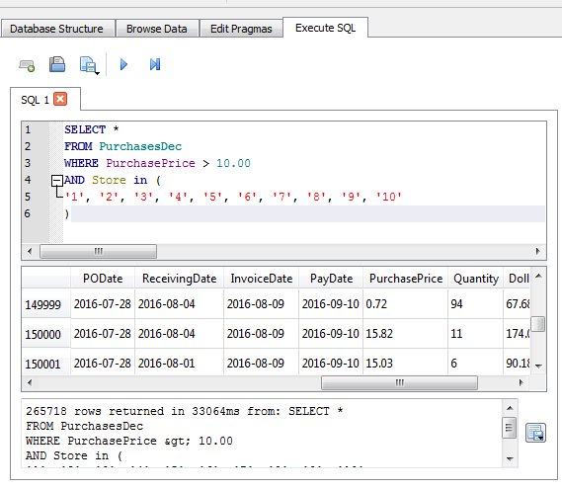
Practice Ex. 3: From table ‘PurchaseDec’, return records for ALL columns where the purchase price is greater than $10.00 for any store numbered between 1 and 10

Slide 20
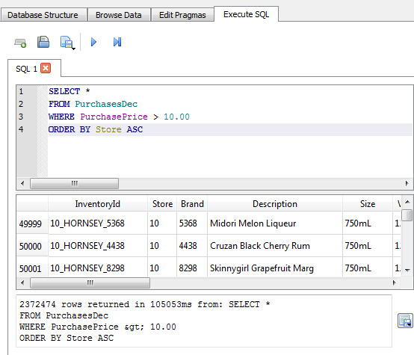
Basic ‘Select” Syntax and Features
‘ORDER BY’ clause is a similar to a Sort feature in excel. Use following syntax to order by a specific column (Note: ASC = Ascending, and DESC = Descending):

Slide 21
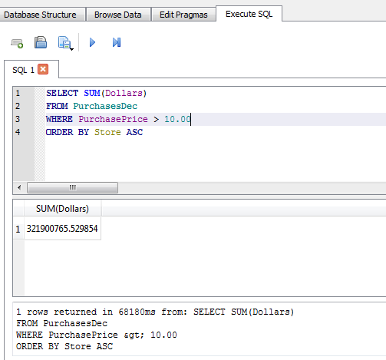
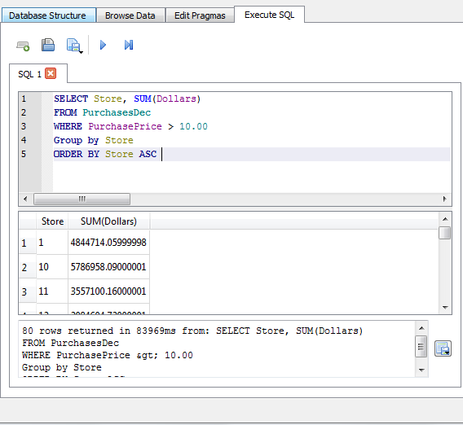
Basic ‘Select” Syntax and Features
Aggregate functions, such as COUNT or SUM, will aggregate all values in a given column if the datatype is an integer or float. Columns SELECTED, but not included in the SUM argument need to be included in both in the SELECT Statement AND the GROUP BY clause.

Slide 22
Practice Ex. 4: From table ‘VendorInvoicesDec’ obtain the total freight costs by VendorNumber for transactions which the Total Dollars value of the transaction was greater than $100 and the quantity was less than or equal to 1000 units. Which VendorNumber corresponded to the largest Freight cost under these conditions?

Slide 23
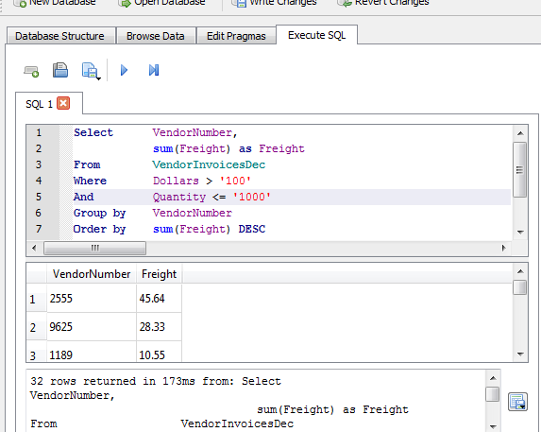
‘Select’ Syntax for Total Freight Cost

Slide 24
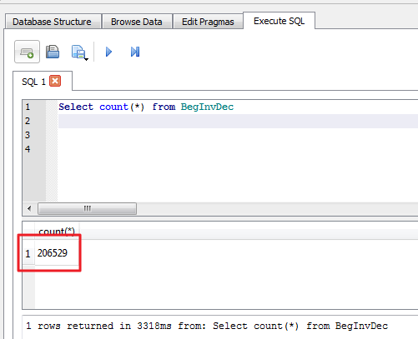
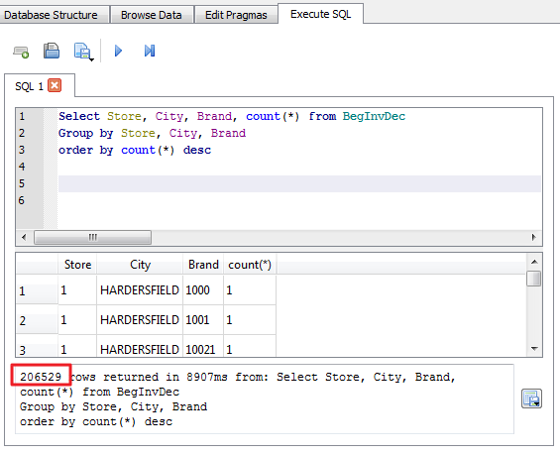
Basic ‘Select” Syntax and Features
The ‘JOINS’ clauses are used to combine records of multiple tables. A JOIN is defined as combining two tables based on common values among specified columns (we typically use primary keys to perform joins). The concatenate of all primary keys in a given table will be unique for each record in the table; one simple method of checking that you’ve properly identified primary keys is to perform a Select/Group (and a COUNT) by those fields---ensuring that record counts match and that there are not counts > 1.
Notes:
Instructor Note: refer to Appendix1_Learner_SQL Joins.doc for more details on SQL Joins.

Slide 25
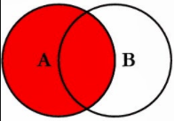
Basic ‘Select” Syntax and Features
There are many types of joins. A very common join used in SQLServer, but is not explicitly provided in SQLite is the left join. A left join will return all records in table 1 (the ‘left’ table) and ‘matched’ records from table 2 (the ‘right’ table). Refer to Appendix1_Learner_SQL Joins.docx for more details on SQL joins.

Slide 26
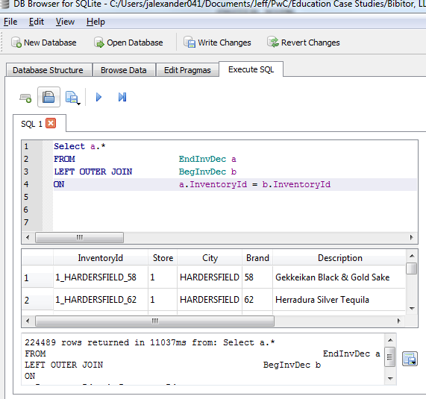
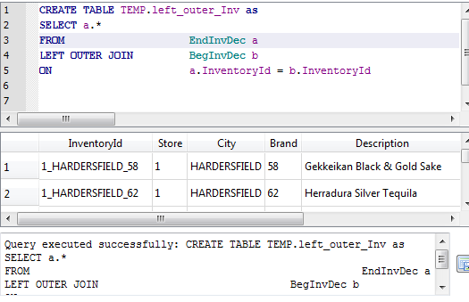
Basic ‘Select” Syntax and Features
In SQLite, we will need to piece this together in three steps. First, we will perform a left outer join using the EndInvDec (‘left’ table) to BegInvDec (‘right’ table) – store results in temp table.
Notes:
Instructor Note: refer to Appendix2_Section1_6i_Joins.txt for ‘SQL joins’ scripts statements.

Slide 27
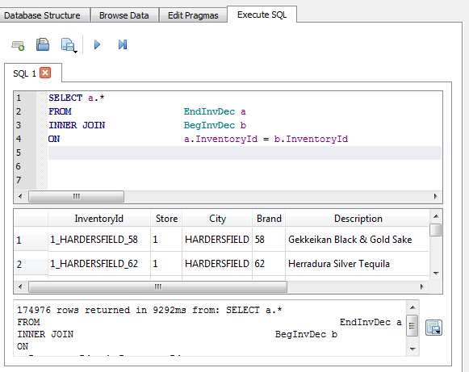
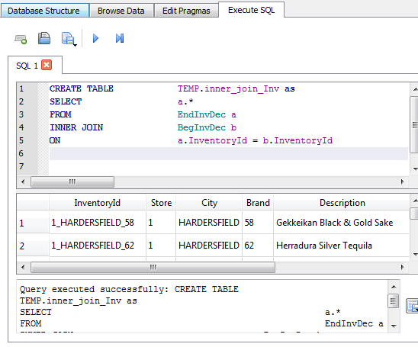
Basic ‘Select” Syntax and Features
Second, we will perform an Inner Join on those two table to identify matched records (store results in temp table):

Slide 28
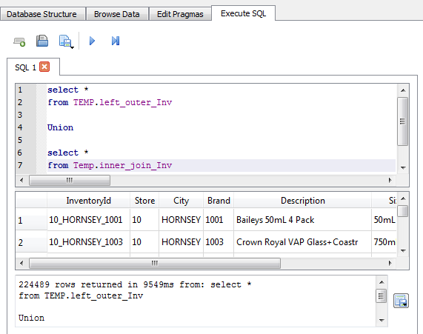
Basic ‘Select” Syntax and Features
Lastly, we will use a UNION clause to combine the two temp tables into a new temp table.
What is one way that we can validate the record count of the new temp table?

Slide 29
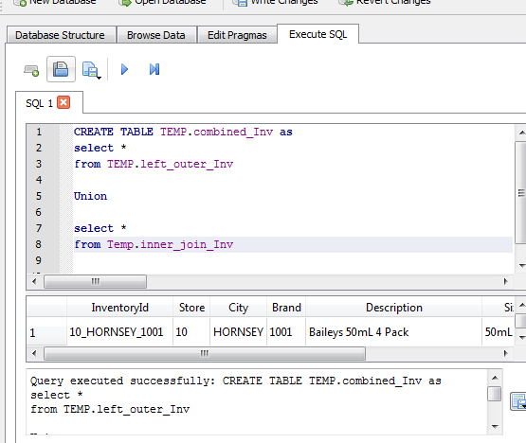
Join Table Successfully Created

Slide 30
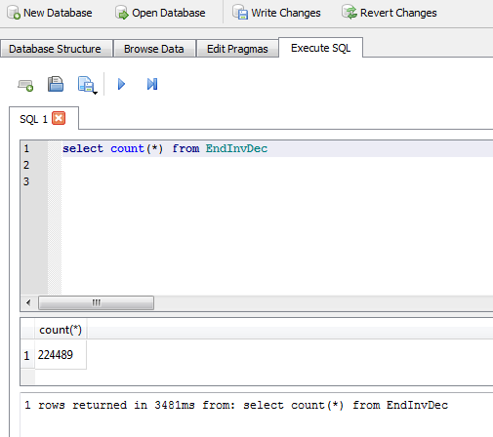
Count of Rows Returned in Table Creation

Slide 31
Case Studies

Slide 32
Instructions
Create vendor billings and purchases activity tables and identify inventory trends outlined in the following two cases

Slide 33
Case 1
Executive leadership is looking for dashboard reporting that would be useful to help identify and monitor vendor activity in order to focus efforts strategically on key supplier relationships.
Create (1) an aggregate table that includes all critical vendor billings and their associated purchasing activity
Create (2) separate tables to store key information, such as ‘top 10 vendors’ by quantity purchased. Name all tables you create ‘c1_Prep_[table_name]’
Note: A 'Critical Vendor' may be based on your judgement and awareness of the data. For example, a vendor with >$1,000 of inventory purchased from.
Notes:
Instructors: Consider if you want your students to submit documentation of completion of the assignment (e.g., export into excel and email excel file, copy screen shots into word doc and email, etc) and modify steps as appropriate.

Slide 34
Case 2
You notice that there is inventory that is purchased but sits on the shelf for a long period of time rather than being sold.
As such, there is an opportunity to add value to the procurement process by identifying trends in the timing inventory purchased versus its corresponding sale.
Consider key data points around purchase prices, seasonality, and vendor information in creating an aggregate table for future visual & statistical analysis.
Name the table you create ‘c2_Prep_[table_name]’.
Notes:
Instructors: Consider if you want your students to submit documentation of completion of the assignment (e.g., export into excel and email excel file, copy screen shots into word doc and email, etc) and modify steps as appropriate.

Slide 35
Next Steps

Slide 36
Phase 2 Pre-work
Download/Install Tableau
Review background information on Tableau and other Data Discovery applications

Slide 37
Thank You.

