Slide 1
Practical Implications of BEPS and Transfer Pricing Adjustments April 5, 2016 Eli Kaneti, Transfer Pricing Senior Manager, PwC Israel
www.pwc.com/il

Slide 2

Agenda
BEPS Transfer Pricing Action Plan Requirements
PwC Tools
Structures likely to be challenged
Transfer Pricing Adjustments

Slide 3
BEPS Transfer Pricing Action Plan Requirements
1

Slide 4
Action Plan
Action 1
Address the challenges of the digital economy
Action 2
Neutralize the effect of hybrid mismatch arrangements
Action 3
Strengthen CFC rules
Action 4
Limit base erosion via interest deductions and other financial payments
Action 5
Counter harmful tax practices more effectively, taking into account transparency and substance
Action 6
Prevent treaty abuse
Action 7
Prevent the artificial avoidance of PE status
Action 8
Assuring that TP outcomes are in line with value creation Intangibles
Action 9
Assuring that TP outcomes are in line with value creation (Risks and Capital)
Action 10
Assuring that TP outcomes are in line with value creation (Other high-risk transactions)
Action 11
Establish methodologies to collect and analyze data on BEPS and the actions to address it
Action 12
Require taxpayers to disclose their aggressive tax planning arrangements
Action 13
Re-examine transfer pricing
documentation
Action 14
Make dispute
resolution mechanisms more effective
Action 15
Develop a multilateral instrument

Slide 5
2
BEPS - Key Themes
3
BEPS Action Plan
Transparency
Economic Substance
Coherence and Consistency of the International Tax System
1

Slide 6
A Three-tiered Approach in the Transfer Pricing Documentation
In Israel - A fourth tier:
1385 Form
Local File
To be shared with each country in which the group operates
Country-by-Country Report
Master File

Slide 7
Documentation
Overview of MNE’s global operations:
Group operational structure
Key products
Intangibles
Financing arrangements
Financial data
TP analysis to supplement Master file
Local business
TP analysis
Financial information
Financial data by country
Revenue
PBT
Tax paid
Capital
Employees
Assets
Master file
Local file
Country by country report
Notes:
Before we run through the process issues and how companies are actually going to meet the country by country requirements, let’s start with the policy background. Why is the OECD doing this; what are they trying to achieve? The transfer pricing documentation is just one part of the BEPS initiative so we must remember that it’s part of a broader framework to curb base erosion through profit shifting, for which the OECD is making a lot of substantive tax rule changes. A big part of BEPS, though, is increasing transparency – this is clear in several of the action items - tax administrations are seeking better risk assessment tools, and they hope that taxpayers will be more conservative in their tax planning if they know that a lot more information is going to be disclosed both about the types of tax planning that they're engaged in. Obviously, the goal here for the OECD is to provide guidance for tax authorities to improve transfer pricing risk assessment through increased transparency, better utilize limited audit resources, and focus on the highest risk cases.
How are they looking to do that? They've got the three-pronged documentation approach. We've got the local file. That builds upon the traditional transfer pricing documentation, basically the same as what we've had historically although with a few changes, the idea being "give us functional analysis, tell us everything you're doing in a particular jurisdiction, prove that the pricing is at an arm’s length.
Now on top of that, they've added the master file, which is the high-level overview of the multinational all around the world, sort of a functional analysis for every part of the organization, asking for things like an organizational chart, details of the global value chain, the important drivers of business profit, IP policies, where you do you do your R&D, things like that. These are things that you might have thought were irrelevant to a traditional transfer pricing analysis, but the OECD is saying, "Give us that so we can put things in context." Obviously, that's more of a qualitative descriptive report.
And then finally the new country-by-country template, which we'll talk about more, that's primarily quantitative, asking for financial information for eight items for all the countries around the world where you do business, things like number of employees, tangible property, and sales. Obviously, the focus is on substance, shining a spotlight on and making it very clear if you've got a situation with a lot of profit being allocated to a low tax jurisdiction with few employees.

Slide 8

OECD Guidance on Country-by-Country Reporting (CbCR) and Transfer Pricing Documentation
CbCR is an annual disclosure, targeted at large companies. The OECD recommends that information disclosed is not released to the public, but there are signs that this may change
Who? | Any multinational enterprises (MNEs) operating in countries adopting OCED’s CbCR guidance (G20, OECD, CIAT, ATAF and more) with revenue > 750M euros ($860M)
What? | County by country report, master file and local file to be submitted annually
Where? | CbC report to be filed with ultimate parent’s home jurisdiction or lower-tier jurisdictions where the MNE operates (secondary mechanism); master file and local file to be filed directly with relevant local tax jurisdictions.
When? | CbC report required for fiscal years starting on or after January 1, 2016 to be filed one year from the close of the related fiscal year (i.e., no later than December 31, 2017); with respect to the US, CbC report required one year after.
How? | The tax authority with which the MNE’s ultimate parent, surrogate parent, or lower-tier entity (subsidiary or PE) filed CbC report will share it via treaty-based exchange
Why? | Enhanced transparency/risk assessments
Notes:
So when is this all going to happen? Remember, substantively the template format was finalized in September of last year. The only question remaining was when would it actually be implemented and in what form? The OECD received lots of comments from businesses saying, "Look, this has to be uniform. We can't have a bunch of different template requirements in different countries, and all this information has to remain confidential." The OECD did the best they could with those requests, and in the implementation package released in February of 2015, all the BEPS countries pledged to implement in a uniform manner, so you'll only have to file this once with your ultimate parent entity, provided your parent country implements CbCR. And the countries pledged not to misuse that data to make formulary apportionment type of allocations.
As for timing, they pledged to implement not before January 1, 2016, but the converse of that is this will be implemented for fiscal year starting on or after January 1, 2016. You'll have 12 months after the close of the relevant fiscal year to file the report, meaning that the first reports will be due by the end of 2017, and they've also given a monetary threshold such that smaller companies are not caught by this. They've said this is for companies with annual revenue greater than 750 million euro per year, that's approximately 1 billion dollars or a little bit under that, depending upon the currency rates and how they fluctuate and what date you use.
There are questions in the U.S. as to precisely how and when implementation will occur, as well as what the exact dollar threshold will be. But I want to emphasize, just to point this out, with respect to the upcoming implementation date, this is coming soon, so this really a very high priority issue.
So why are companies so particularly concerned about his? There are several possible implications from the country by country report – number 1, I think, it is likely to create a lot more transfer pricing disputes. And also with the potential for public disclosure of this information, there are issues with respect to confidentiality of the data being filed and reported. But the first issue, before you even get to those, is really, well, am I ready to file this? What's the actual compliance burden and the implementation requirements for companies to be able to actually gather this data and report it? This really will be a significant administrative burden, and while this is a lot of work for the tax department, the responsibility for this runs across the organization involving controllership, regulatory, and corporate responsibility. The tax department will be responsible for filing it but it's not just the tax department's responsibility and it’s important to start socializing this message now so that the key stakeholders in your company recognize the resources from non-tax departments that will be needed to meet this compliance requirement.
Your ability to comply with this is obviously going to be very dependent upon their current state. What do your existing end-to-end transfer pricing systems look like? What's your business culture? How are your core ERP and business intelligence capabilities currently? Are you an acquisitive company that's done a lot of transactions and picked up different ERP systems? That's going to affect an organization’s ability to be able to comply with this new reporting requirement. Even for companies that don’t feel as though they have risky structures or don’t have large profits in low tax jurisdictions need to recognize that just managing and complying with the reporting requirement is a significant issue that needs to be addressed soon.
In the meetings that we’ve had with other clients, we've seen varying levels of responses. Some companies are in pretty good shape but they really are the exception. A lot more companies I think will need to do a lot of work simply to be able to comply with this new documentation burden, so there really is no standard approach. At this point, many organizations still don't really realize how difficult this will be. It really is deceptively complicated.

Slide 9
PwC Tools
2

Slide 10
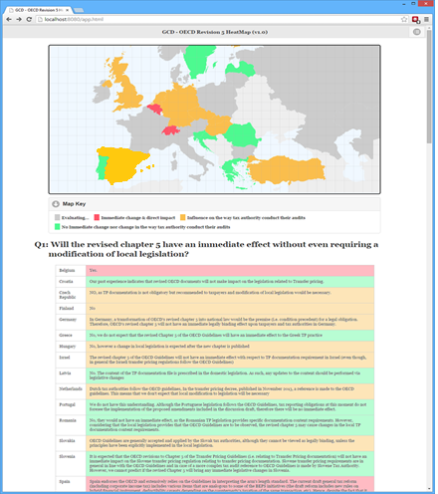
GCD Adoption Tracker
An internal tool that assesses by jurisdiction the expected near-term impact of the OECD’s Chapter V changes.
The tool provides an assessment based on responses to three questions related to the impact of the revised OECD Chapter V in a specific country.
The adoption tracker tool produces a heat map based on the following colour index:
Commitment to implement OR rapid implementation expected
Influence on the tax authority AND
any changes expected over medium
term
No/limited change AND/OR
no/limited influence on tax authority
RED
YELLOW
GREEN

Slide 11
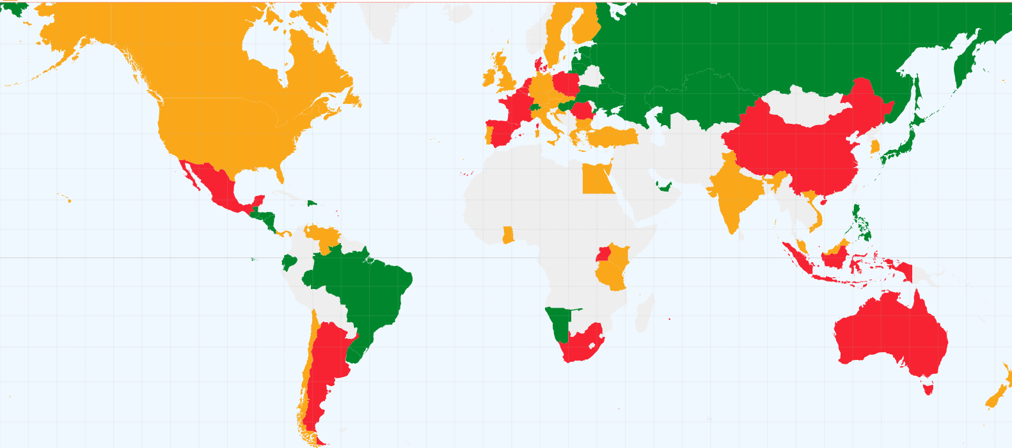
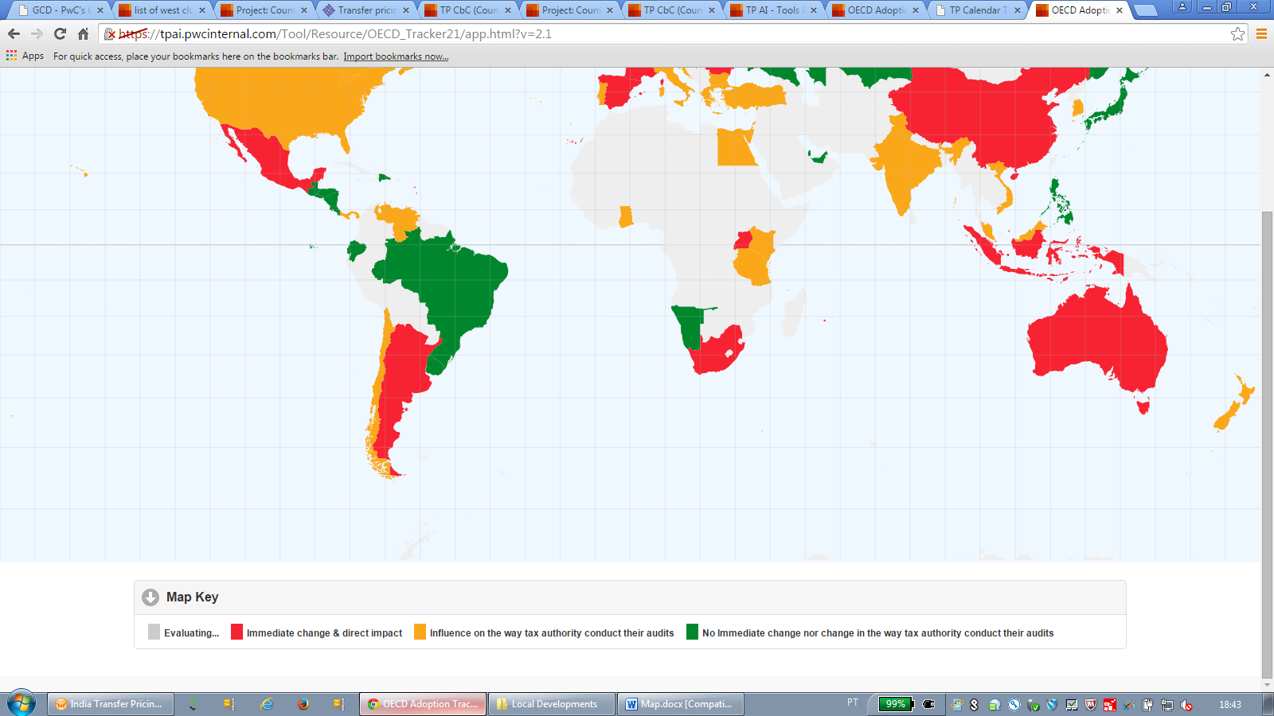
GCD Adoption Tracker
https://tpai.pwcinternal.com/Tool/Resource/OECD_Tracker21/app.html?v=2.1

Slide 12
Documentation – CbC Analyzer
Data diagnostic analysis using key intercompany ratios
Visualized comparison of entities within selected tax jurisdictions
World heat map highlights tax jurisdictions requiring special attention and identifies key pressure areas
Quantitative basis for qualitative BEPS impact assessment and remediation planning

Slide 13
Structures Likely to be Challenged
3

Slide 14
So Practically What is the Impact of BEPS?
R&D structures
Management relocation
Sales/ marketing
Notes:
Focus on substance = transfer pricing and PE
secure outcomes that see operational profits allocated to the economic activities which generate them
Extreme as to extent conduct differs from legal contract, conduct succeeds

Slide 15
So Practically What is the Impact of BEPS?
R&D structures
What’s changed?
Transfer Pricing
Intangibles
Risk
Impact
R&D Co considered to be the economic owner of the IP
IP Co entitled to return for financing
IP Co
(Bermuda)/(US)
R&D
What are groups doing?
Review substance within IP Co
Substance is activity NOT only number of people and NOT only legal contract
Understand value chain of the business and key risks
Ensure value drivers and key risks are being overseen and managed by IP Co
R&D Co
(Israel)
Notes:
IP Co provides funding to R&D Co in relation to developing new IP
R&D Co operates autonomously performing the ongoing management and maintenance of the IP and makes all decisions in relation to the IP in respect to the licensing
R&D Co remunerated on a contract R&D basis via a cost plus
conduct will supplement or replace the contractual arrangements if the contracts are incomplete or are not supported by the conduct
controls decisions concerning the exploitation of the intangible and has the practical capacity to restrict others from using the intangible
Legal ownership of intangibles, by itself, does not confer any right ultimately to retain returns derived by the MNE group from exploiting the intangible
The identity of the member or members of the group performing functions related to the development, enhancement, maintenance, protection, and exploitation of intangibles, therefore, is one of the key considerations in determining arm’s length conditions for controlled transactions.
An associated enterprise providing funding and assuming the related financial risks, but not performing any functions relating to the intangible, could generally only expect a risk-adjusted return on its funding;
• If the associated enterprise providing funding does not exercise control over the financial risks associated with the funding, then it is entitled to no more than a risk-free return;

Slide 16
So Practically What is the Impact of BEPS?
Management relocation
What’s changed?
Current risk
Transfer Pricing
Intangibles
Risk
Impact
US Co considered economic owner of IP
IP Co remunerated for functions it performs; support services
IP Co
(Israel)
Product Sale
US Co
(US)
What are groups doing?
Substance and value chain review
Management/ staff awareness of tax impact
Instructions and guidelines for Management/ staff
LRD?
Notes:
IP Co is legal owner of IP
Management of the group have moved to the US to further build and distribute the product
Management make all decisions in respect to the IP
IP Co left with a small team to oversee the IP
Assess intangible and the risks of the business.
Important persons in relation to the IP
Economic substance follows people
Associated enterprises performing important value-creating functions related to the development, maintenance, enhancement, protection and exploitation of the intangibles can expect appropriate remuneration;

Slide 17

What Will be Treated as BEPS Structures
Sales/ Marketing
What’s changed?
Current risk
Permanent Establishment (PE) now clarified and codified
Impact
IRS look to attribute Israel Co profit to a taxable presence in US
Uncertainty over the profits attributable to PE
Israel Co
(Israel)
Sales/ Marketing Services
Sales Co
(US)
PE of Israel Co
(US)
What are groups doing?
Understand role and value of sales function
Who is performing the ‘principal role’
‘Do’s and Don'ts’ for sales/ marketing people
Review/ reconsider TP on Sales Co
Sales/ marketing people compensation structure
Restructure to distribution model
US Market
Notes:
Company A sells products and services through a website
Company B looks to source opportunities
Once Company B has negotiated terms in principle customer then signs up on Company A website
Example could also be where no sales co in Israel and US Co persons are frequently located in Israel.
Avoiding taxable presences is a key focal area of BEPS and common risk to manage from globalisation. OECD have tightened up wording on PE to restrict these scenarios.
TA’s asking for Taxable profits of PE of US Co vs Sales Co

Slide 18
Transfer Pricing Adjustments
4

Slide 19
What is a Transfer Pricing Adjustment?
Generally intended to achieve a specific arm’s length profit to demonstrate pricing compliance from an income tax perspective.
It is occasionally necessary to make transfer pricing adjustments when actual financial results differ from projected results.
Can create risks (e.g. from a customs perspective) or may possibly not even be allowed in certain countries.

Slide 20
When is a Transfer Pricing Adjustment Necessary?
Number of observations
Arm’s length
range
Return %
Min
25th
50th
75th
Max
Result of tested party
If the result of the tested party falls within the relevant range (either interquartile or full range depending on the country/method), the transaction will be considered to have occurred at arm’s length.
If the result of the tested party does not fall within the relevant range, the transaction is not considered to be at arm’s length and the tax authorities would enforce an adjustment to the median.
Usually, it is not recommended to target points close to the 25th or 75th percentile since, if the tax authorities challenge the benchmark results, the company could find itself outside of the new range (and thus be required to make a adjustment to the new median).

Slide 21
Distribution Model Example
IL parent company and IP owner distributes its products through its US subsidiary (LRD).
Company uses the TP mechanism of targeting an operating margin (ROS).
A search is conducted resulting in an interquartile range of 1.50% - 4.50% with a median of 2.95%.
The company earns an operating margin of 3.0% and therefore falls within the range. The TP regulations do not require an adjustment.
FY 2015 | US Distributor (subsidiary)
100 | Third party sales
(47.0) | Cost of sales (Intercompany price)
(50) | General and admin expenses
3.0 | Operating Profit
3.0% | Operating Margin
Count | 10
Min | 0.50%
25th | 1.50%
50th | 2.95%
75th | 4.50%
Max | 9.20%

Slide 22
Examples of a Transfer Pricing Adjustment
The company earns an operating margin of 0.40% and therefore falls below the interquartile range.
The TP regulations require an adjustment to be made in order to lower the price.
If the company does not make an adjustment and does not lower the price, the tax authorities will adjust so that the operating margin is 2.95% (the median).
FY 2015 | US Distributor (subsidiary)
100 | Third party sales
(49.6) | Cost of sales (Intercompany price)
(50) | General and admin expenses
0.5 | Operating Profit
0.40% | Operating Margin
Count | 10
Min | 0.50%
25th | 1.50%
50th | 2.95%
75th | 4.50%
Max | 9.20%

Slide 23
Examples of a Transfer Pricing Adjustment
The company earns an operating margin of 7.70% and therefore falls above the interquartile range.
The TP regulations require an adjustment to be made in order to raise the price.
If the company does not make an adjustment and does not raise the price, the tax authorities will adjust so that the operating margin is 2.95% (the median).
It is important to be aware that some countries may impose restrictions or not allow credits to be performed.
FY 2008 | US Distributor (subsidiary)
100 | Third party sales
(42.3) | Cost of sales (Intercompany price)
(50) | General and admin expenses
7.7 | Operating Profit
7.70% | Operating Margin
Count | 10
Min | 0.50%
25th | 1.50%
50th | 2.95%
75th | 4.50%
Max | 9.20%

Slide 24
Ex Ante Vs. Ex Post
As a general rule, prices in third-party transactions are set ex ante when the transaction is first negotiated.
However, most documentation studies focus on testing the "arm's-length nature" of transfer prices after the results of the transaction are known.
While the OECD Guidelines and the transfer pricing rules in certain countries place greater emphasis on the arm's-length nature of the price-setting process, tax authorities in these countries will nevertheless generally look at after-the-fact results.
In case of a limited-risk entity, ex post results should not deviate much from expected ex ante results. Any such deviations may imply an inappropriate transfer pricing policy.

Slide 25
Big Bang
Gradual
When to Perform a Transfer Pricing Adjustment - Gradual Vs. Big Bang
Companies can monitor throughout the year (quarterly/monthly) and amend the pricing in the following period accordingly or perform one lump sum adjustment at the end of the year.
Consideration should be given to local country legislation.
Adjustments typically made around the last day of a fiscal year, but before closing the financial books.
Such adjustments force reported financial results into a specified range.
Raise VAT and other tax issues and exposures e.g. when the transaction involves tangible goods that are subject to VAT and customs.
In some countries, the big bang works only after meeting certain criteria (e.g,, it can be clearly demonstrated that the new prices are arm’s length).
In some countries, phase-in is the only way to deal with the potential objections of the tax authority.
Under periodic-monitoring approach, companies track and compare actual results with forecasts on an ongoing basis.
As a general rule, the longer the forecast period, the less reliable the pricing mechanisms.
Our recommendation is to reduce the forecast periods by resetting transfer prices periodically during the year.
A relatively small lump sum year end adjustment may still be required.

Slide 26
General Considerations
Supported by intercompany agreements.
Adjustment to COGS vs. operating expenses.
Adjustment to tax return only creates a book-to-tax difference:
Increase the audit risk for income tax;
VAT;
Customs;
Double taxation.
Some countries require demonstration of reasonable efforts to achieve an arm's length outcome. This is usually supported by transfer pricing documentation.
Adjustment symmetrically in the accounts in both jurisdictions involved.
Applying the same approach consistently over time.
US tax return, form 5472 requires declaration on consistency between transfer pricing and customs valuations property import into the US from related parties.

Slide 27

Thank you
Vered Kirshner
PwC | Tax Partner Office: +972 3 7954849
Mobile: +972 54 5651358
Email: vered.kirshner@il.pwc.com
Eli Kaneti
PwC | Transfer Pricing Senior Manager Office: +972 3 7954689
Mobile: +972 54 6660236 Email: eli.kaneti@il.pwc.com

